Slide 1
Making notes from readings and writing a full reference
Week 5 Communication and IT

Slide 2
Read the text book section 2.1-2.4
What are the two ways of note taking that are suggested in the book?
How do these compare with the way that you take notes?
In your school, what options do you have for notetaking?
E.g. can you write on a text book or paper copies of readings
Do you have electronic copies of text books or readings
What kind of notetaking would work best for you?
Notes:
The text book suggests writing on textbooks but students may not be able to do this as they may be using shared books. Students may not have the computer software to annotate any electronic readings they have so it may be that the best way to take notes is to write them on paper or on a document on their computer

Slide 3
One way of notetaking suggested by the textbook
Main Idea | My comments/questions | Answer to my comments/questions

Slide 4
Making notes using a table
What I am looking for | Reading 1 (put the reference) | Reading 2 (put the reference)
What diarrhoeal disease is | My notes | My notes
How diarrohoeal disease is spread
The signs and symptoms of diarrhoeal disease
What community members can do in their home to prevent the spread of diarrhoeal disease
Notes:
Here is a different way of making notes- students have questions to answer for their assessment so they could use a table to make notes on what they find out from the readings. This way they can see if the information from both articles is the same or different

Slide 5
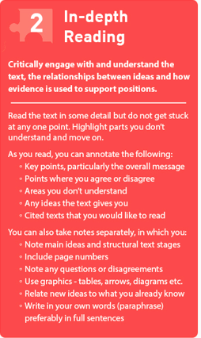
Annotate a text
Decide what you want to know from the text – what are you looking for? Annotate the text as you read
Make notes from your annotations
At the top of your notes, write down the reference to the text (so when you look back at your notes, you know which text it was)
Notes:
Here is another way to think about reading in depth

Slide 6
Key point
Reading in depth means you can explain the key points of the article to somebody else
Writing notes about what you have read will allow to check whether you have understood the reading

Slide 7
After class work: make notes on the readings for assessment 1
Make a table in your notebook like the table on slide 4 and begin to make your own notes
Remember you need to use your own words when you make notes- you cannot copy exactly from the reading

Slide 8
Follow up on after class work: compare your notes
Did you make notes on all of the questions in the table?
Use your notes to explain to a partner what you have learned about diarrhoeal diseases

Slide 9
Referencing correctly

Slide 10
Some questions about referencing
What is referencing?
Why reference?
What is plagiarism?
What referencing system should I use?
Are there general rules for referencing?

Slide 11
What is referencing?
Acknowledging sources of information or ideas in your assignment .i.e. saying where you got the information from
  (books, journal and newspaper articles, websites, government documents etc.)
You must include a reference to a source if you:
  Paraphrase (express someone else’s idea using your own words)
  Summarise (express someone else’s idea in a reduced form using your own words)
  Quote (express someone else’s idea using their exact words)
  Copy (reproduce a picture, graph or diagram)

Slide 12
Why reference?
to show that you have read and understood the research/important information published in your area of study
to strengthen or support your argument/explanation
to add details, examples, background to your ideas
to avoid plagiarism
so that you will pass your assignment!

Slide 13
How do you reference
There are several referencing systems
They all achieve the same purpose – they just do it in different ways
Some use the ‘author date’ system
Some use a number system (the article for Assessment 1 by Seidu et al. 2020 uses a numbering system)

Slide 14
What referencing system should you use?
You are going to use APA 7th. Here is a quick guide to APA 7th from the University of Technology Sydney
APA 7th quick guide
Notes:
If possible, give students a handout on the APA 7th referencing system

Slide 15
Two places where references appear in your assignment
You need to do both!
In text (citation)
  (Author surname, year of publication)
Reference list (at the end of text)
  You need to provide all of the details of the publication so that another person could find it

Slide 16
Activity
Look at the reference list for the journal article
There are different kinds of references that the article refers to
Look at the first 10 references and decide for each one if it is:
A book
An edited book
A journal article
Something else

Slide 17
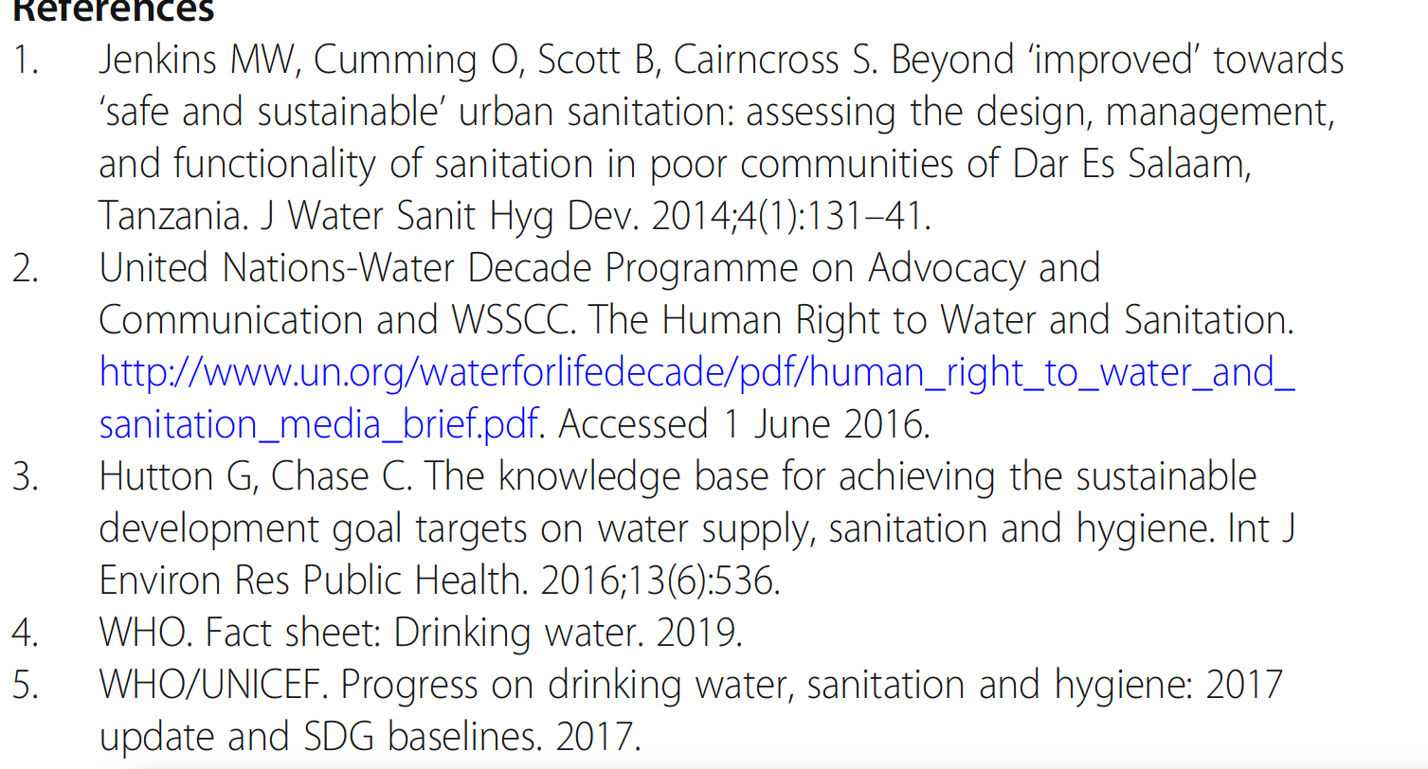

Slide 18



Journal article
Webpage (organisational author)
Journal article
Webpage? Or report?

Slide 19
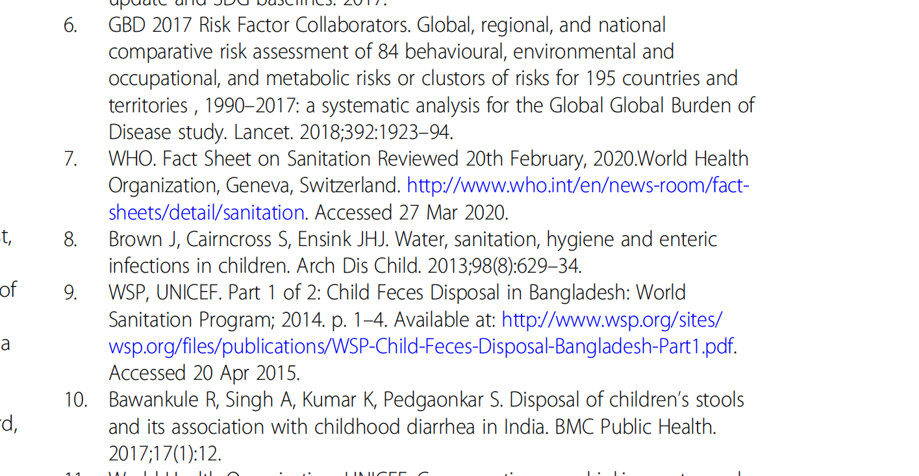

Slide 20
Journal article
Report (organizational author)
Journal article
Report (organizational author)
Journal article

Slide 21
Reference list
The reference list goes at the end of your assessment. It is a list of all the things you have used in your assessment
List the references in alphabetical order (remember the reference list in the Seidy et al. (2020) is using a different system - it is not APA 7.

Slide 22
How to write a full reference in APA 7 style
Use the journal article that you are reading for assessment 1.
Look at the referencing guide for APA 7
What information do you need to find to write the full reference?
In pairs, work out what information you need and then see if you can find it on the article

Slide 23
You need
Authors
Date of Publication
Title of article
Title of journal
Volume and issue number
Page numbers

Slide 24
Write the information in the correct APA 7 format
Use the APA 7 guide to help you write a full reference for the journal article

Slide 25
Seidu, A. A., Agbaglo, E., Ahinkorah, B. O., Dadzie, L. K., Bukari, I., Ameyaw, E. K., & Yaya, S. (2020). Individual and contextual factors associated with disposal of children’s stools in Papua New Guinea: evidence from the 2016–2018 demographic and health survey. BMC public health, 20, 1-11.

Slide 26
You can also use google scholar to help you write the reference
Search for the article in google scholar
Click on the ‘cite’ button and select APA

Slide 27
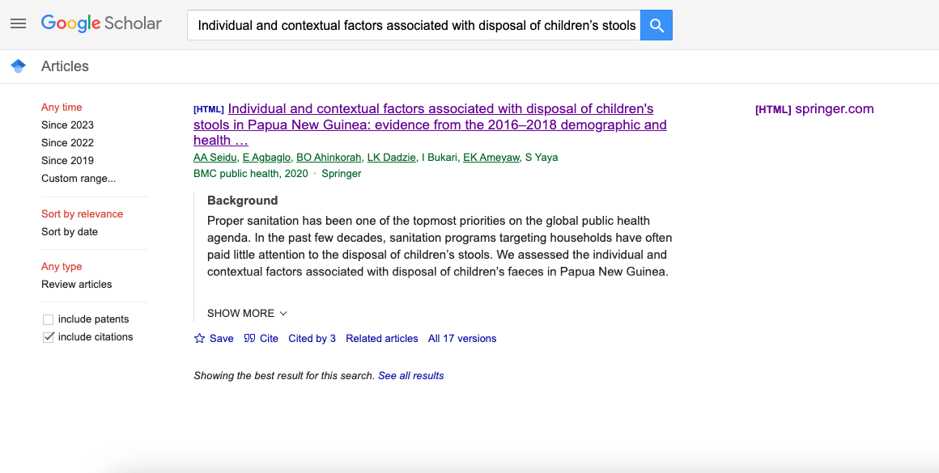



Slide 28
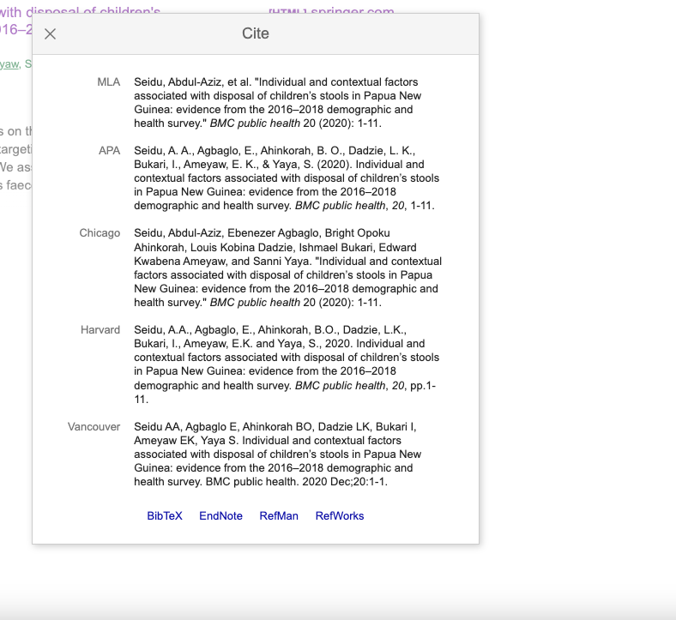


Slide 29
After class work
Write the full reference for the WHO fact sheet on diarrhoeal disease

