Slide 1
Reading journal articles

Slide 2
What are journal articles?
Journals are written by academics/researchers
They are usually written for other academics (i.e. they ae not directly written for students so they are usually harder to read than a textbook)
A peer reviewed journal article means that the articles were read by other experts before they were accepted for publication
There are different types of journal articles

Slide 3
Reading for evidence: being a critical reader
Peer reviewed journal articles are a good place to begin if you are looking for good evidence because they have already been read and approved of by experts in the field BUT you still need to be a critical reader
Ask these questions begin to think critically about something you are reading (or listening to)
Where was it published?
When was it published?
Who wrote it?
Why did they write it? (to inform people, to report on research, to persuade you about something etc.)
What evidence are they using/where did they get the information?

Slide 4
Key learning points
It is important that you are a critical reader so that you can make decisions as a nurse based on good evidence

Slide 5
Purpose in reading
Before you start reading you need a PURPOSE for reading. The purpose is often related to an assignment.
Today our purpose for reading is to begin to prepare for Assignment 1. We want to find out information about diarrhoeal disease and especially the information we need to complete the assignment

Slide 6
Find the answers to these questions
Where was it published?
When was it published?
Who wrote it?
Why did they write it? (to inform people, to report on research, to persuade you about something etc.)
What evidence are they using/where did they get the information?
Notes:
Give students in pairs or small groups 10 minutes to see if they can find the information to answer the questions on the slide

Slide 7






Date it was published
Name of journal
Title of the article tells you what it is about and how they got their information
Authors
Notes:
Show students where to find the information

Slide 8
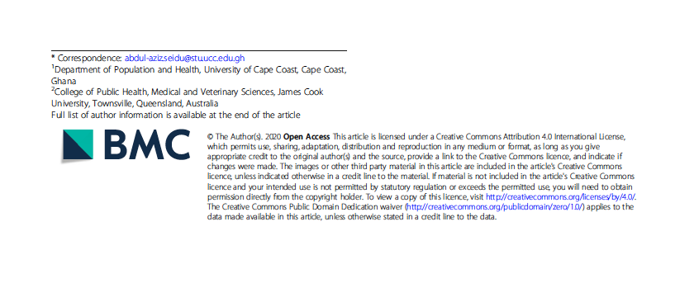


Usually there is information about where the authors work

Slide 9
Preliminary reading (skimming)
Before you read in detail, you want to skim the text to get an overview. Why?
To decide whether this is something it is worth spending time reading
To get an idea what it is about – it will then be easier to read
Because you have limited time and just want to get a quick overview

Slide 10
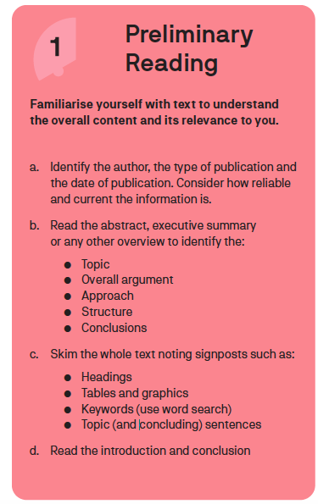
This are good strategies to use when you are searching for articles
They are also good strategies to use to get a quick idea of what the article is about and to help you decide if you want to read it in more detail
The strategies can also help you decide which parts of the article might be most useful to read
Notes:
This is from the reading infographic – keep using this so students get used to it. We have already done a)

Slide 11
After class work: Do your own preliminary reading
Spend 15 minutes and see how much you can understand the reading.
Remember to use any subtitles to help you quickly get an idea of what the reading is about
Read the introduction and conclusion

Slide 12
Follow up on after class work: What did you find out about the article
Tell your group what you already know about the article
What did you do to get that information – how did you read and what did you read?
Notes:
This is to an opportunity for you to see how much of the article students can understand before you give them more guidance Point out figure 1 and see if students looked at that – it’s an easy figure to understand

Slide 13
Use the structure of a journal article to help you read
Abstract | Summarises the whole paper
Introduction | Background, what research has been done before, purpose of this paper.
Methods | How the research/or literature review was done.
Results | What the authors found
Discussion | What the results mean. How do the results from this study compare with what other studies have found.
Conclusion | Summary of key points. Sometimes limitations. Often implications – what does the study mean for practice or future research?

Slide 14
Which sections should you read?
In journal articles, reading the introduction and conclusion will give you an overview of the key points
Other sections of the text will give you different information – you do not always have to read the whole journal article. What you need to read depends on WHY you are reading

Slide 15
Read the introduction to get an idea of what the paper is about
If you read the beginning and the last paragraph of the introduction, you will probably find out what the background is and what the purpose of the paper is
The other paragraphs will give you information about things that are already known about this topic/problem
Reading the topic sentences will give you an outline of the arguments the writers are making

Slide 16
What is a topic sentence?
The topic sentence is usually (but not always) the first sentence in the paragraph. It summarises what the paragraph is about.

Slide 17
Stop and think
Write down a few things you have heard so far that you think you can try when you read your next journal article

Slide 18
Let’s read the introduction of this article
Background
As evident in the Sustainable Development Goal (SDG) six, proper sanitation has been one of the topmost priorities on the global public health agenda [1, 2]. This is because inadequate sanitation leads to the spread of disease-causing organisms through faeces and urine [3]. These organisms cause a variety of diseases, including cholera, diarrhoea, dysentery, hepatitis A, typhoid, and polio [4]. Globally, there are over 2.3 billion people without access to improved sanitation [5]. Research by Global Burden of Disease [6] pegged the global sanitation related deaths at 775,000 annually. In low- and middle-income countries, about 5% of all deaths result from poor sanitation, while the global average is 1.4%. In the Pacific, about 70% of the population still use unimproved sanitation facilities, with 13% practicing open defecation [7]. The situation is worse in Papua New Guinea, where only 19% of the population have access to improved sanitation [7].
Notes:
You might want to read this aloud to students sentence by sentence and ask if they can put it into their own words- or you explain it. This first paragraph explains what the problem is – that inadequate sanitation leads to diarrhoeal diseases. The numbers in this paragraph refer to evidence – it is a way of referencing with a number system so at the end of the article you can look up the number and find the reference. You might want to explain this to students but also tell them that this is not the style they will be using in their assessments- they will be using author date rather than a number.

Slide 19
Can you answer?
What is the health problem that his article is about?
What is one of the main causes of this health problem?
What is the situation in PNG regarding this health problem?

Slide 20
Paragraph 2 from the introduction
In the past few decades, sanitation programs targeting household sanitation have often paid little attention to the disposal of children’s stools. This results from the belief that children’s stools or faeces are less harmful compared to faeces of adults [8, 9]. However, that belief has been proven to be false, as evidence suggests that children’s stools can cause more serious faecal contamination in the household environment [10]. This is because, through some behaviour such as playing on the ground or crawling, children get their fingers exposed to faecal pathogens. Such children are also likely to put pica or fomite into their mouths [10]. It is, therefore, very important for every household to practice safe disposal of children’s faeces by putting the faeces into toilet/latrine or burying it. Practices such as putting it in a drain or ditch, and throwing it in the garbage or in the open are considered unsafe practices [11].
Notes:
You might want to read this paragraph with students – or if you think they can read it themselves, ask them to read it and then explain what the main point is – that disposing of children’s faeces in a safe way is important

Slide 21
Can you answer?
Why is it important to throw away children’s faeces safely?
What are some safe ways of throwing away children’s faeces?
What are some unsafe ways of throwing away children’s faeces?

Slide 22
Introduction 3rd paragraph
Previous studies in India [12, 13], Bangladesh [14], Nigeria [15], Burkina Faso [16], and Ethiopia [17] have revealed positive associations between disposal of children’s stool, and individual/maternal and contextual/ household factors. These studies have shown that women with high wealth status, those with higher levels of education [15, 16], women who live in urban areas [17], and those who have access to improved toilet facility [12, 17, 18] are more likely to safely dispose of children’s stool. These studies have provided adequate literature through their findings and recommendations which include strengthening policies that can increase caregivers’ awareness and practice of safe sanitation practices at all levels and in all livelihood domains [15, 16]. However, to the best of our knowledge, no study of this kind has been conducted in Papua New Guinea. In the present study, we sought to assess the individual and contextual factors associated with disposal of children’s stools in Papua New Guinea. This work will be beneficial to sanitation programs aimed at promoting safe disposal of children’s faeces.
Notes:
This paragraph begins by telling you what research has been done on this topic in other countries, and it reports the main findings that better educated, wealthier, and people in urban areas are more likely to dispose of faeces safely. Previous research has also recommended improving policies so that people know about the importance of throwing away faeces safely. Then it finished with what this paper is about – that so far there has not been any research in PNG and that is what this article is about

Slide 23
Can you answer?
What are some of the factors that influence whether caregivers throw away faeces safely – according to previous research?
What is this paper about?

Slide 24
So an introduction …
Gives you background to the topic
Tells you what research has been before
Tells you what research is missing still (often this is called ‘the gap)
Tells you what this article is about (usually filling ‘the gap’

Slide 25
Then read the conclusion
Policy implications
The results from the study have revealed that there is relatively low prevalence of safe disposal of children’s faeces in Papua New Guinea. There are both individual and contextual factors associated with disposal of children’s stools. It is recommended that various policies and programs aimed at improving safe disposal of children’s faeces should focus on both individual and contextual factors. Specifically, sanitation programs should focus on behavioral change and not only on the extension of water and improved toilet facilities.
Conclusion
The individual level factors associated with disposal of children’s faeces are child’s age, maternal age, and women visiting health facility for child diarrhea while the contextual factors are region of residence, sex of household head, type of toilet facility, and source of drinking water. Further studies could assess the association between the availability of hand hygiene resources (presence of water and soap for handwashing) and disposal of children’s stools.
Notes:
Read this with students and make sure they can explain the conclusion and policy implications in their own words.

Slide 26
Can you answer?
What is the situation in PNG with disposing safely of children’s faeces?
What should future policies focus on?
What are some of the individual factors that influence whether parents throw away faeces safely?
What are some of the contextual factors that influence whether parents throw away faeces safely?

Slide 27
After class work: Write some notes
Spend 15 minutes writing what you now know from the article:
What are the main points that you have understood?
What information do you have so far to help you answer the questions for Assessment 1?
What do you still need to find out?

