Slide 1
Reading effectively

Slide 2
What do you usually read and how often do you read?
Talk in groups
Think about what is easy and what is difficult
Write up on the board everything you read, under the columns easy, medium or difficult columns
Notes:
The purpose of this is to get students to begin to think about different types of reading. There are different purposes for reading and the reading they need to do for their studies and as a nurse will be different from what they read to socialize with people, catch up on the news etc. They need to learn to judge how good the evidence is for what they are reading. Put three columns on the board – easy, medium, difficult so students can write up the different types of reading in each column, according to how easy or difficult it is for them to read eg, text message might be easy, a chapter from a text book might be difficult

Slide 3
Reading for evidence: being a critical reader
How do you know that what you are reading is good evidence?
Where was it published?
Who wrote it?
What evidence are they using?
Notes:
Talk about needing to know where the information came from

Slide 4
What counts as good evidence for my studies and as a professional
Journal articles
Textbooks
Government reports
Clinical guidelines
Health policies
Can you think of anything else?
Notes:
So at university, they will be doing different kinds of readings. What is important is that the reading they do to learn about nursing and when they are a nurse is based on evidence so here are some examples of things that are usually based on evidence

Slide 5
What about …?
Facebook
Instagram
YouTube
Notes:
What might the problem be with these sources? Anybody can publish on these platforms. They can easily spread the wrong information .

Slide 6
You need to know
Where was it published?
Who wrote it?
What evidence do they have?
The library at the University of Technology Sydney has great material on searching and helping you evaluate evidence
https://studyguides.lib.uts.edu.au/nursing/evaluatinginformation

Slide 7
Jigsaw reading activity
Today we are reading a WHO factsheet that you need to use to complete Assessment 1.
Would you trust this as a source of evidence? Why or why not?
In groups you are going to read a section of the factsheet and then share it with other students

Slide 8
Do the jigsaw reading activity
Make four groups
Each group will read a different section of the WHO fact sheet on diarrhoeal diseases.
Group 1: Key facts:
Group 2 scope of diarrhoeal disease; and dehydration
Group 3: Causes
Group 4 Prevention and treatment
Step 1
In your groups, read and make sure you understand your section of the fact sheet so that you can explain what you have read to somebody else who has not read that section. You can talk to other students in your group to help each other.
Notes:
If you have a large class, you might want to have 2 x group 1; 2 x group 2; 2 x group 3; 2 x group 4

Slide 9
Jigsaw reading: Step 2
Make a new group
In your new group there should be four people who have read different sections of the WHO factsheet (so from the previous step, a group 1, 2, 3, and 4 member)
Each student is to explain what you have read to the other students in your group.
By the end of the activity, you should know the answers to these questions:
What is diarrhoeal disease?
Why is it a problem for children?
What are the main causes of diarrhoeal disease?
What are ways of treating diarrhoeal disease?
What are ways of preventing diarrhoea disease?

Slide 10
In class or after class
Make notes on each of the questions on the previous slide.

Slide 11
The key learning points from today

Slide 12
You need a clear purpose for reading
Before you start reading you need a PURPOSE for reading. The purpose is often related to an assignment.
In this reading activity, your purpose was to find out about a specific aspect of diarrhoeal diseases

Slide 13
You can use different reading strategies to help you read effectively
Read the ”Reading at University’ handout
Which of these strategies have you used today to help you read the WHO factsheet?

Slide 14
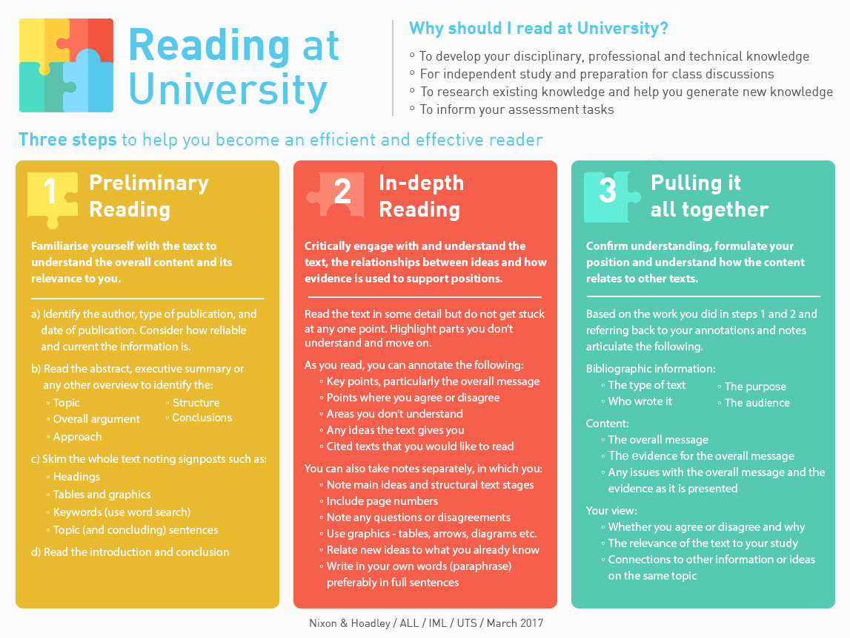

Slide 15
Talking about what you have read with another student
One way to check if you have understood what you have read is to try and explain it in your own words to somebody else

Slide 16
Practise these reading strategies
Use the reading strategies you have practiced today to help you read in your other subjects.

