Slide 1
Reading effectively
Caroline Havery, Academic Language and Learning, IML

Slide 2
Today
How to read journal articles effectively

Slide 3
Apart from your nursing study, what do you usually read and how often do you read?

Slide 4
What’s different about reading at university?
The type of text
The type of language
The amount of reading
What you have to do with what you have read

Slide 5
Different types of reading for different purposes
Academic texts
Workplace texts
Journal articles
Textbooks
Government reports
Patient notes
Clinical guidelines
Health policies

Slide 6
What about …?
Facebook
Instagram
YouTube

Slide 7
Reading for evidence: being a critical reader
How do you know that what you are reading is good evidence?
Where was it published?
Who wrote it?
What evidence are they using?

Slide 8
It was published on the internet!
Where?
By whom?
What evidence?
The library at the University of Technology Sydbey has great material on searching and helping you evaluate evidence
https://studyguides.lib.uts.edu.au/nursing/evaluatinginformation

Slide 9
Reading for evidence for your your assessments
Start with the readings provided to you in your subject

Slide 10
How are you going to read?
How do you usually read?
What reading strategies do you already have?
How successful have your reading strategies been (do you find reading easy, difficult, enjoyable…)?

Slide 11
How to read journal articles
Journals are written by academics
They are usually written for other academics (i.e. they ae not directly written for students so they are usually harder to read than a textbook)
A peer reviewed journal article means that the articles were read by other experts before they were accepted for publication
There are different types of journal articles

Slide 12
Some types of journal articles
Research paper | To report on original research
Systematic literature review | To analyse all previous research on a specific topic. A systematic literature review reports on how they chose the studies they review and how they found them
Other literature reviews | These are also an analysis of research on a specific topic but they do not necessarily outline the approach they used to find literature
Commentaries | These are like ‘opinion’ pieces

Slide 13
What is your purpose for reading?
Before you start reading you need a PURPOSE for reading. The purpose is often related to an assignment.
In this lecture my purpose for reading is to find out if communication training works.

Slide 14
Use the structure of a journal article to help you read
Abstract | Summarises the whole paper
Introduction | Background, what research has been done before, purpose of this paper.
Methods | How the research/or literature review was done.
Results | What the authors found
Discussion | What the results mean. How do the results from this study compare with what other studies have found.
Conclusion | Summary of key points. Sometimes limitations. Often implications – what does the study mean for practice or future research?

Slide 15
Today, we are reading the following article

Slide 16
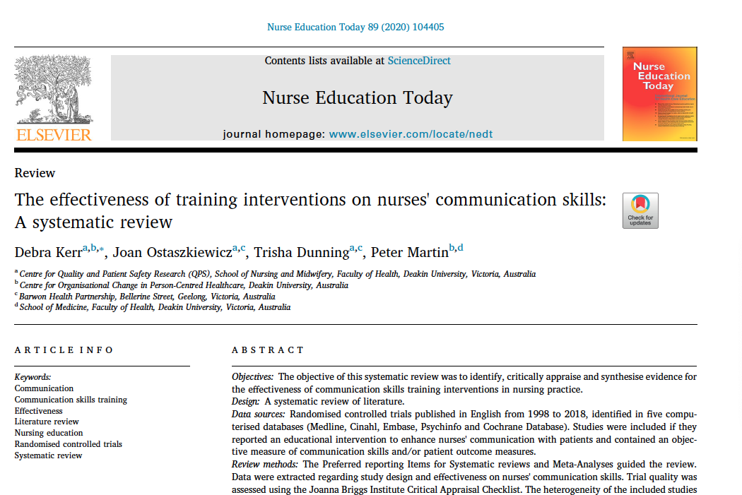




Slide 17
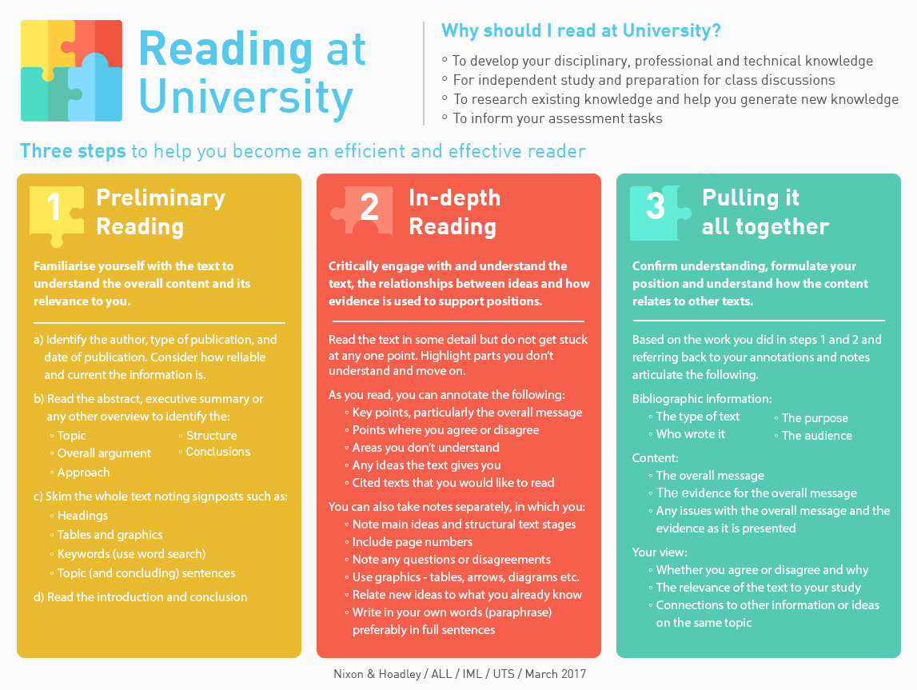

Slide 18
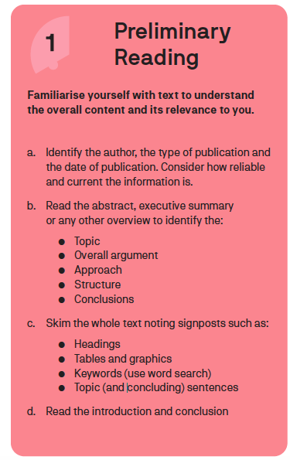
This are good strategies to use when you are searching for articles
They are also good strategies to use to get a quick idea of what the article is about and to help you decide if you want to read it in more detail
The strategies can also help you decide which parts of the article might be most useful to read

Slide 19
Read the abstract for the article by Kerr et al. (2020)
What is this paper about?
What did the authors find out?

Slide 20
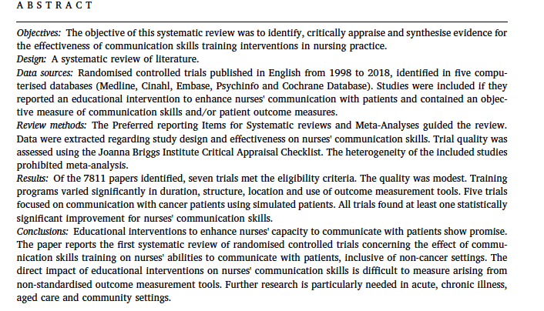



Slide 21
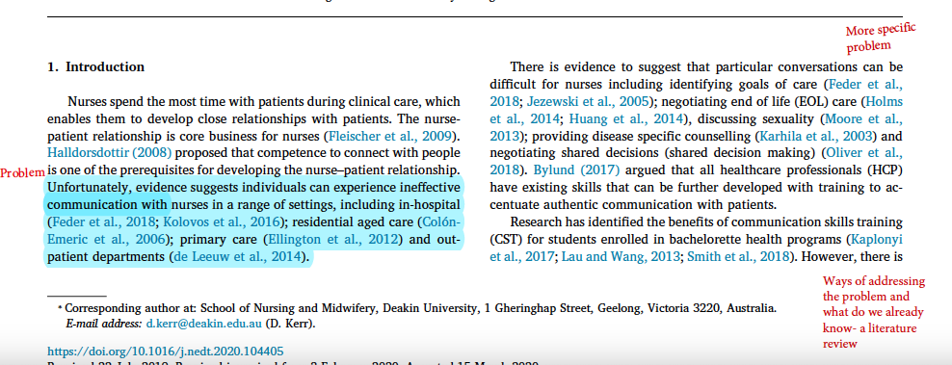
Using the structure of the text to help you read
significance

Slide 22
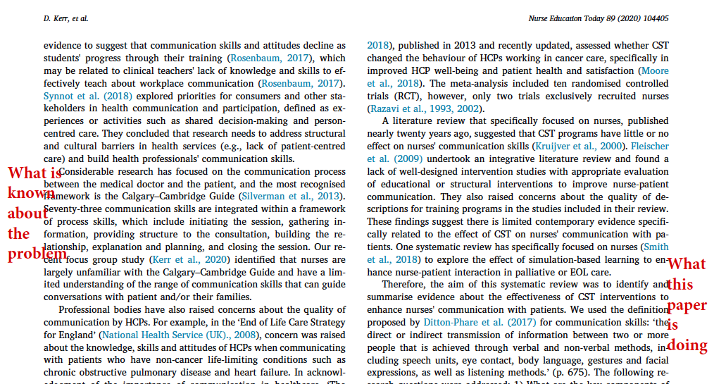
Gap in research

Slide 23
Reading topic sentences can help you get a good overview of a section of the article (here the introduction)
Nurses spend the most time with patients during clinical care, which enables them to develop close relationships with patients.
There is evidence to suggest that particular conversations can be difficult for nurses including identifying goals of care (refs); negotiating end of life (EOL) care (refs), discussing sexuality (ref); providing disease specific counselling (ref) and negotiating shared decisions (shared decision making) (ref).
Research has identified the benefits of communication skills training(CST) for students enrolled in bachelorette health programs (refs).
Considerable research has focused on the communication process between the medical doctor and the patient, and the most recognised framework is the Calgary–Cambridge Guide
These topic sentences are from Kerr et al. (2020, pp 1-2)

Slide 24
Professional bodies have also raised concerns about the quality of communication by HCPs.
Research shows nurses can be more concerned about task-orientated care rather than engaging in conversation with patients, families and caregivers (refs).
Several literature reviews show doctors, nurses and allied health staff can be trained to communicate more effectively with patients during EOL healthcare encounters (refs); maternity care (ref); oncology care (refs); dementia care (ref) and during intensive care admissions (ref).
The majority of systematic reviews which have examined the effectiveness of CST for enhancing communication include multiple HCP disciplines (medical doctors, nurses, midwives, students, specialist physicians and allied health staff) (refs).
A literature review that specifically focused on nurses, published nearly twenty years ago, suggested that CST programs have little or no effect on nurses' communication skills (refs)
Therefore, the aim of this systematic review was to identify and summarise evidence about the effectiveness of CST interventions to enhance nurses' communication with patients.

Slide 25
Why read like this?
If you read the beginning and the last paragraph of the introduction, you will probably find out what the background is and what the purpose of the paper is
The other paragraphs will give you information about things that are already known about this topic/problem
Reading the topic sentences will give you an outline of the arguments the writers are making

Slide 26
Stop and think
Write down a few things you have heard so far that you think you can try when you read your next journal article

Slide 27
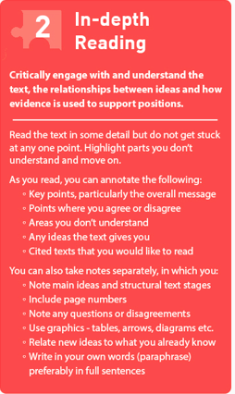
Annotate a text
Decide what you want to know from the text – what are you looking for? Annotate the text as you read
Make notes from your annotations
At the top of your notes, write down the reference to the text (so when you look back at your notes, you know which text it was)

Slide 29
Finding another reading for assessment 2 in HCC
A reminder:
Look for high quality resources (see the library CRAP test)
Look for recent resources (the exception is if there is a paper that is exceptionally important in your field – usually known as seminal work)
Look briefly at a number of papers before you choose to get an idea of what kind of resources there are
-the titles and abstracts will give you an idea of what kind of themes/topics might be related to your issue/topic area
Look at the resources provided by the library to make sure you have a good search strategy to choose your resources

Slide 30
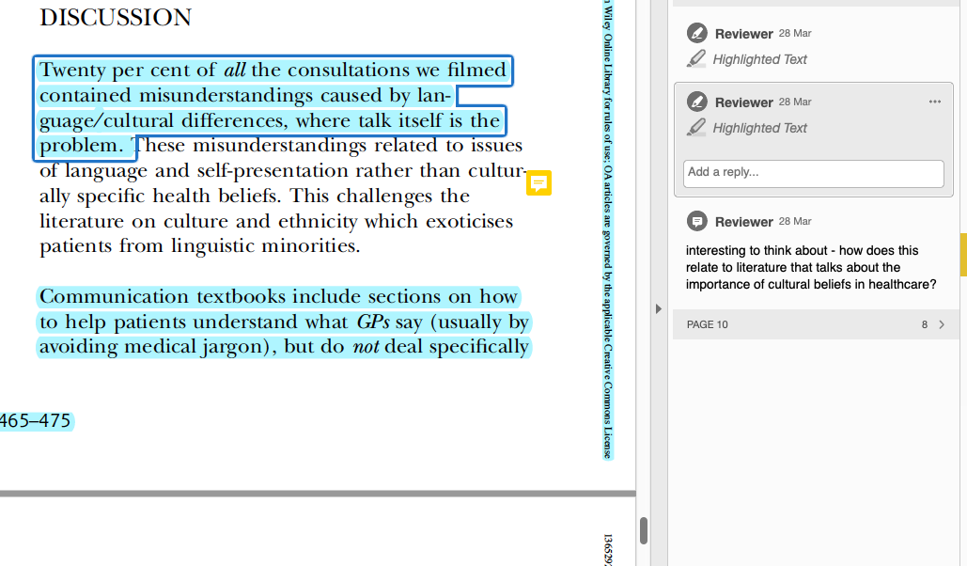

Slide 31
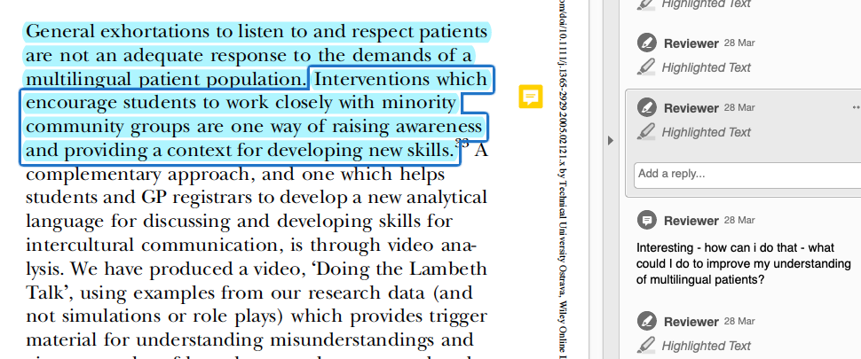

Slide 32
What did I do?
I used the same strategies as in preliminary reading
I then read and thought about the ideas in the text and connected the ideas to my context – like having a conversation with the text
How do these ideas relate to my purpose?
How do these ideas relate to my context – what is the same and what is different?
Could I use any of these ideas in my assessment?

Slide 33
Making notes
What systems do you have for making notes?
What experience do you have of making notes?
What works well for you in making notes?
What challenges do you have in making notes?

Slide 34
Making notes using a table
What I am looking for | Article 1 | Article 2
Is communication training necessary | My notes | My notes
Does communication training work
What needs to be included in communication training

Slide 35
How can I read more and more effectively
How to read critically UTS HELPS
Set scheduled times to read – when you are alert and can focus
Read regularly – try reading for a set time each day
If you have a long train journey and can sit down, read on the train
Put away all distractions when you read (phones etc.)
Reflect on whether you think reading is getting easier as you continue to read

Slide 36
Stop and think
What can you use from this lecture in your own reading?
What strategies do you have that work for you that I have not talked about?

