Slide 1
UTS HELPS
How to Study Effectively

Slide 2
Workshop Objectives
1. To learn about some services that could enhance study
2. To examine science-backed learning strategies

Slide 3
Discussion
How to Study Effectively
What is the main difference between school and university?
Notes:
At school, you are mostly presented with knowledge as something that is definite and “true”. You are expected to be able to understand that knowledge, and know which situations that knowledge might be useful for.
At university, we focus on knowledge as something that has been created over a period of time. It has been created by people asking questions about a particular aspect of the world, then finding ways to try to answer those questions. Other people have then looked at how those questions were answered, and explained why they think the method of answering the question was either valid or not valid. If many people within that discipline agree that the question has been answered using reliable forms of research, and interpreted in a way that is valid, and not based on biases or assumptions, then over time it comes to be considered knowledge. Otherwise, it gets rejected (by most, but maybe not all, members of that disciplinary community). There is a lot of disagreement amongst members of these disciplinary communities, and a lot of ongoing discussions and debates, which you are firstly introduced to, and then expected to join.

Slide 4
Possible Answers
School | University
Managed learning | Learning independently
Frequent feedback | Less feedback
Less flexibility | More flexibility
Classes | Lectures, workshops, internships
More time for readings | A lot of readings and less time

Slide 5
Studying at university means….
Learning to think in a way that is suitable for your discipline.
Image Source: pxfuel.com.com

Slide 6
Studying at university means….
Learning what types of questions are asked in your discipline.
Learning how to answer those questions in ways that are valid, credible and reliable.
Evaluating theories, concepts, evidence and arguments used to answer those questions.
Notes:
For example, Engineering begins with a problem that needs to be solved. Engineers ask questions to define the problem, determine criteria for a successful solution, and identify constraints.
Law asks which legal principles underpin a particular case, and whether those principles can be satisfactorily applied in a given situation based on the information that is known.

Slide 7
What does this mean for you?
You are expected to do a lot of research beyond the information given to you by your lecturers.
You are expected to give opinions, propose theories or make recommendations.
They must always be based on your interpretation and evaluation of the evidence.
Notes:
This also means you need to understand that different people may have tried to answer the same question in different ways, or interpreted the same research findings differently, and therefore come up with different answers, theories or recommendations.
You need to show your teachers that you have done enough research to know some of the main differences of opinion between experts, and then explain which interpretation you agree with, and why (based on the evidence available).

Slide 8
Important information to support your academic journey

Slide 9
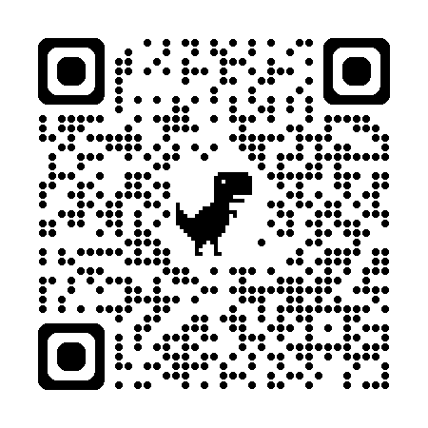
A date to remember:
Scan the code and answer the following question with the person beside you:
When is census date?
Bonus question:
Why is census date important?
Notes:
To find the answers:
https://www.handbook.uts.edu.au/dates_academic.html#on2024
Bonus question:
Census date is the cut off time to withdraw from a subject without incurring financial or academic penalty.
At this point, ask students if they know where to go if they need help withdrawing from a subject

Slide 10
Question
How to Study Effectively
If you need help with changing your subjects, where should you go?

Slide 11
Building 10
Student Centre
Notes:
Sometimes, studying effectively means managing the workload that you have. It can be difficult to focus if are enrolled in more than you can handle. Therefore, consider reducing your study load. Although if you are an international student, you will need to make sure that this does not affect your visa status by checking in with the International office.

Slide 12
Where to Study
Library
Reading Room
WriteNow
Group study rooms

Slide 13
Library
Building 2
Levels 7, 8 and 9
Notes:
There are several floors that are designated quiet spaces. However, it tends to be a bit noisier than the Reading Room. If you find that there are disruptive students, please let the library staff know.

Slide 14
Reading Room
Building 2 Levels 5 and 6
Notes:
The reading room is a well-lit quiet space for students to study. If there are disruptive students, there is a security office by the 5th floor entrance that you can report to.

Slide 15
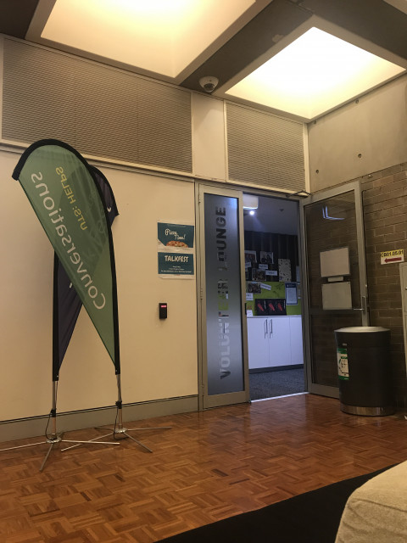
WriteNow
Building 1
Levels 5
Room 01
Every Tuesday
12:00pm-4:00pm
13 August – 29th October
Notes:
This is a study space that is staffed by HELPS, FirstBASE and Accessibility. It is a quiet space that is designed with minimal distractions. There will be a pomodoro timer to help you focus and remind you to take breaks. One staff member from HELPS, FirstBASE or Accessibility will always be present and if you need assistance with your written assignment, HELPS assignment chat drop-in is just next door.
WriteNow will be running every Tuesday from the 13th August to 29th October, 12:00pm to 4:00pm

Slide 16
Group study rooms
Scan
Notes:
These study rooms are located around building 2. You can scan the QR codes outside of the room to book them.
This list is not exhaustive; there are more study areas throughout the campus. Keep an eye out and don’t be afraid to ask a staff member if you are not sure.

Slide 17
Assignment Support
Daily workshops
Individual consultations
Online writing reviews
Online self-help resources
Sample written assignments
 www.helps.uts.edu.au
Notes:
When you need help during your study, come to HELPS!

Slide 18
Where can you go if…
…want to adjust your study load
…need help with the subject content
…are stressed or procrastinating
…need writing or presentation support
…have maths or science questions
…have accessibility needs
Student Centre
Lecturer or Tutor
Counselling Service
UTS HELPS
Mathematics & Science Study Centre
Accessibility Service
Notes:
Sometimes just reducing your study load could significantly improve your study experience
Reach out to your subject coordinator, lecturer or tutor if you have content issues. You might also consider the Student Association to find a private tutor or in some cases, look up U:PASS to see if your subject has a support class available.

Slide 19
Study Strategies

Slide 20
5 Study Techniques
Retrieval practice
Dual coding
Spaced practice
Interleaving
Feynman technique
Notes:
Here are 5 techniques that are recommended by cognitive scientist.
Test them, practise and see which ones work best for you.

Slide 21
1. Retrieval Practice
What is it?
Actively trying to recall what you have learned
Why does it work?
Forcing the brain to recall information, makes memory of target information stronger
Helps to identify strengths and gaps in knowledge
Notes:
helps to identify strengths and gaps in knowledge. For instance, if you have trouble remembering something, it means that is the thing you need to give more time to study

Slide 22
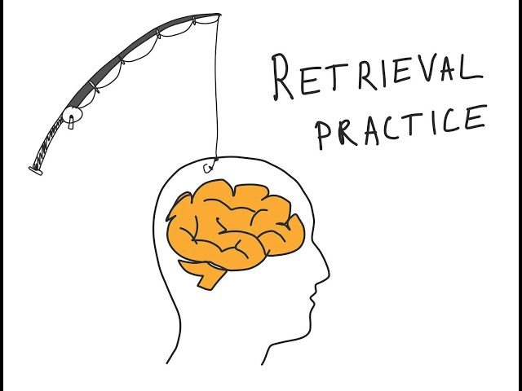
1. Retrieval Practice
How can I do it?
Past test papers
Flash cards
Paper and pen
Image source: https://www.youtube.com/watch?v=22DkzlS7TmY
Notes:
Past papers might be obtained from your lecturers and tutors or from your U:PASS leaders
You can use physical cards or download apps such as Quizlet onto your phone
Choose a topic to study. Then, with a piece of paper and a pen, write down as much as you can remember and then compare it against the information your are trying to recall

Slide 23
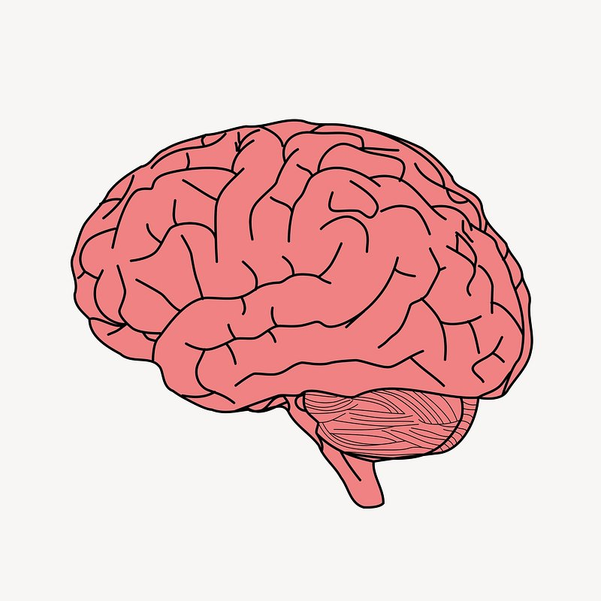
2. Dual Coding
What is it?
Using a combination of images and words to improve memory retention
Why does it work?
The brain engages information mainly through two systems:
visual
+
verbal
processing information
IMPROVES
long-term retention
Notes:
Further reading:
https://www.structural-learning.com/post/dual-coding-a-teachers-guide
The brain engages information mainly through two systems: visual and verbal [teacher note: when you bring out the +, say: Using both simultaneously]
improves information processing and thus long-term memory retention

Slide 24
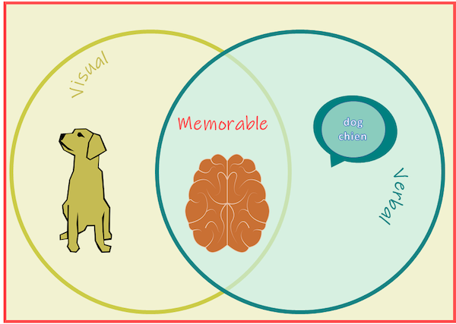
2. Dual Coding
How can I do it?
Mind maps and concept maps
Posters
Timelines
Drawing
Image source: https://www.structural-learning.com/post/dual-coding-a-teachers-guide
Notes:
Try to transform written/audio information into:
Mind maps or concept maps
Posters
Timelines
Images and drawings
Go one step further and see if you can explain what you have created in writing.

Slide 25
3. Spaced Practice
What is it?
Reviewing materials in short study sessions more frequently instead of cramming
Why does it work?
The brain forgets over time
Resting allows brain to recover
Cramming over-taxes the mind; reducing performance
Notes:
The brain forgets over time – studying at the point in time when the brain forgets improves long-term retention. Therefore, study more frequently after learning new information. Periods between sessions can increase as the information becomes more embedded in long-term memory.
Resting is important in allowing the brain to operate optimally
Cramming fatigues the mind reducing performance

Slide 26
If you haven’t revised it regularly, you haven’t learnt it
Image Source: flickr.com
Notes:
The Ebbinghaus Curve of Forgetting further explains why spaced repetition is effective.
Without regular revision, most newly learnt material is gone within 24 hours.
Consider starting each study session with a brief revision of what you covered in the previous session.

Slide 27
3. Spaced Practice
How can I do it?
Try to review new material within 24 hours
Short study sessions
Review older material before newer material
Rest in between sessions
Avoid cramming
Plan ahead
Image source: https://www.youtube.com/watch?v=yfNO8LL0PMQ
Notes:
Further readings:
https://citl.indiana.edu/teaching-resources/evidence-based/spaced-practice.html#:~:text=Spaced%20(or%20distributed)%20practice%20refers,activities%20in%20between%20study%20periods.
https://www.oxfordlearning.com/what-is-spaced-practice/

Slide 28
4. Interleaving
What is it?
Mixing different subjects/topics when studying
Why does it work?
Builds connections between topics, reinforcing retention and understanding
Makes differences and similarities more obvious
Notes:
helps to identify strengths and gaps in knowledge. For instance, if you have trouble remembering something, it means that is the thing you need to give more time to study

Slide 29
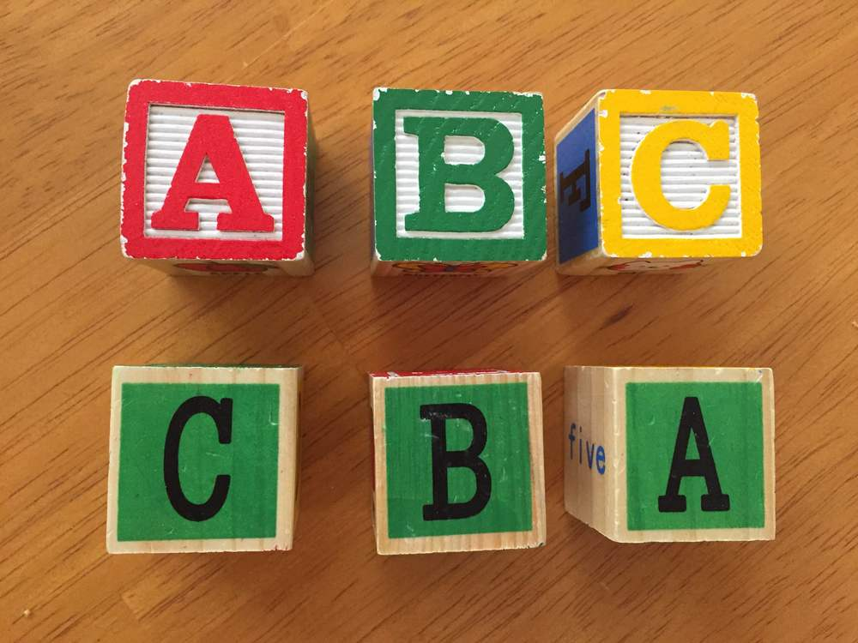
4. Interleaving
How can I do it?
Choose subjects to interleave carefully
Avoid topics that are too different
Avoid topics that are too similar
Image source: https://www.learningscientists.org/blog/2016/8/11-1
Notes:
Further reading:
https://effectiviology.com/interleaving/

Slide 30
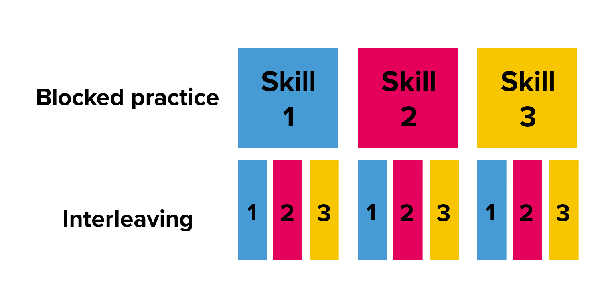
Image source: https://www.youtube.com/watch?v=22DkzlS7TmY
Notes:
Example of how to interleave 3 different topics.
Further reading (image source):
https://www.century.tech/news/what-is-interleaving-and-how-can-it-help-students/

Slide 31
5. Feynman Technique
What is it?
Also known as the protégé effect
Simplifying a complex topic then teaching it
Why does it work?
Helps process information
Forces knowledge to transform and become part of the learner
Notes:
Richard Feynman was a Nobel prize winning physicist.
Transforming knowledge means that the information become part of the learner. The understanding is deeper compared with simply memorising something.

Slide 32
5. Feynmen Technique
How can I do it?
Pick a topic
Imagine teaching a child
Identify gaps
Review and simplify
Image source: https://todoist.com/inspiration/feynman-technique
Notes:
Identify gaps in own understanding when trying to explain. What are you struggling with? Go back to source materials
Teaching helps to solidify the information further. You might even get questions that force you to think deeper and thus increase your understanding.
Further readings:
https://fs.blog/feynman-learning-technique/
https://fs.blog/feynman-technique/#:~:text=Feynman's%20learning%20technique%20comprises%20four,notes%20and%20revisit%20them%20regularly.

Slide 33
Extra Technique: Enter Flow State
Notes:
[Optional]
What is flow state?
A state of mind that allows a person to perform tasks effortlessly and with focus; even over long stretches of time
Benefits:
Increases productivity
Enhances learning
Reduces procrastination
How?
Choose the level of challenge carefully: not too difficult but not too easy
Set clear goals to help make progress clear
Break complex or lengthy tasks into smaller chunks
Set additional parameters to increase stakes; this increases motivation. For example, set a timer for a task.

Slide 34
What is Flow State?
An altered state of mind allowing increased focus and creativity

Slide 35
Benefits
Increased productivity
Enhanced learning
Counters procrastination
Image source: https://hooshmand.net/flow-state-in-the-zone/

Slide 36
How to achieve a Flow State
Choose the level of challenge carefully: not too difficult but not too easy
Set clear goals to help make progress clear
Break complex or lengthy tasks into smaller chunks
Set additional parameters to increase stakes; increasing motivation
Choose the right place to study
Image source: https://www.getclockwise.com/blog/flow-state-of-mind/
Notes:
Set additional parameters to increase stakes; increasing motivation:
For example, set a timer for a task or finish a task before a song ends
Further reading:
https://hooshmand.net/flow-state-in-the-zone/

Slide 37
Questions
???

Slide 38
UTS HELPS
 9514 9733
 helps@uts.edu.au
 www.helps.uts.edu.au
.

