Slide 1
Dr Anne Summers AO

Slide 2
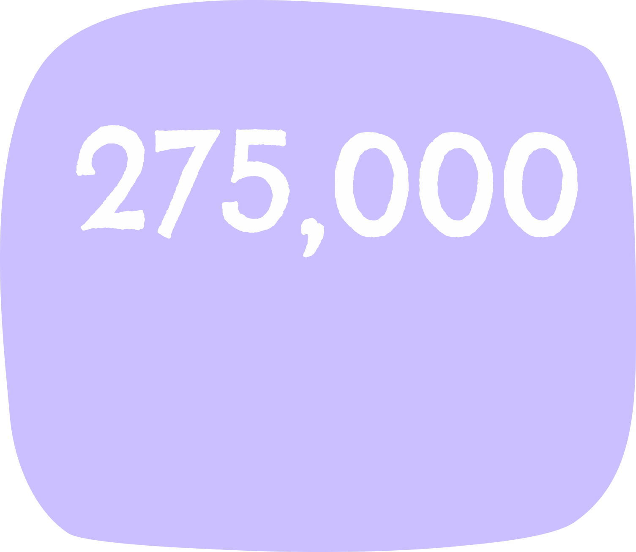
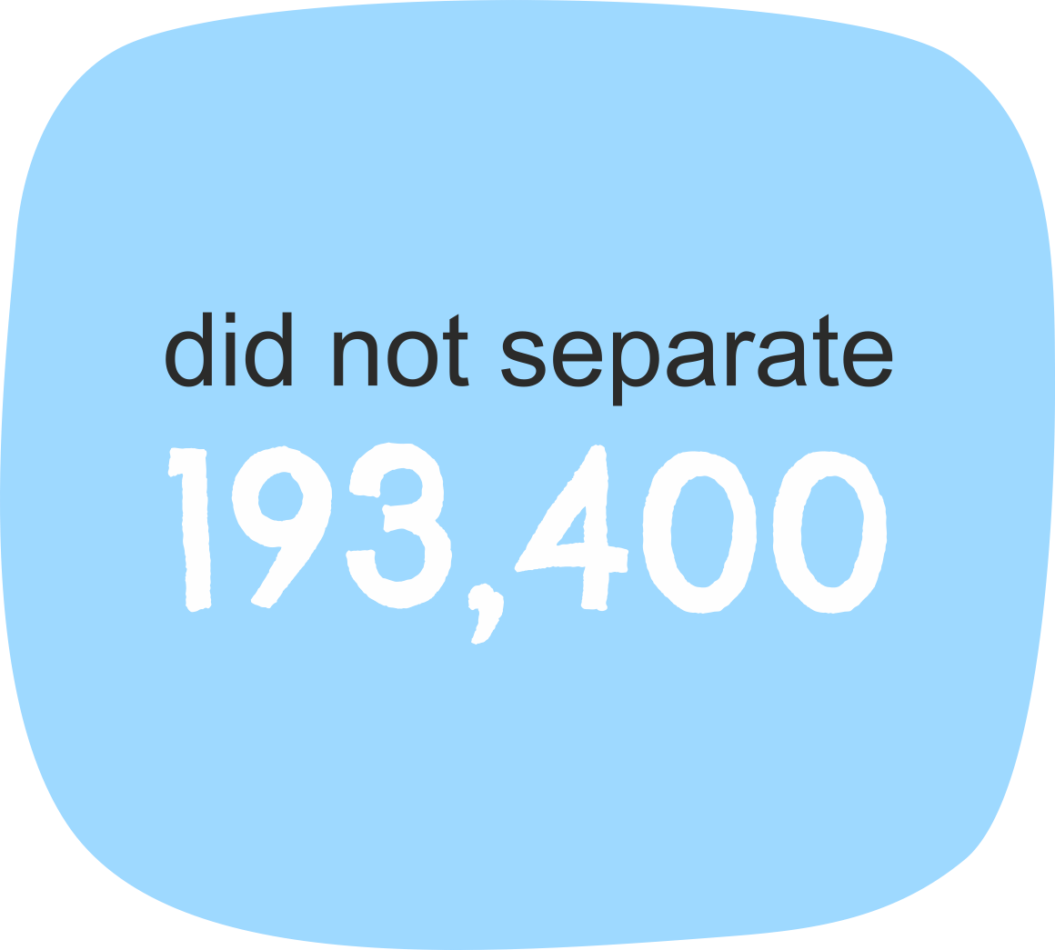
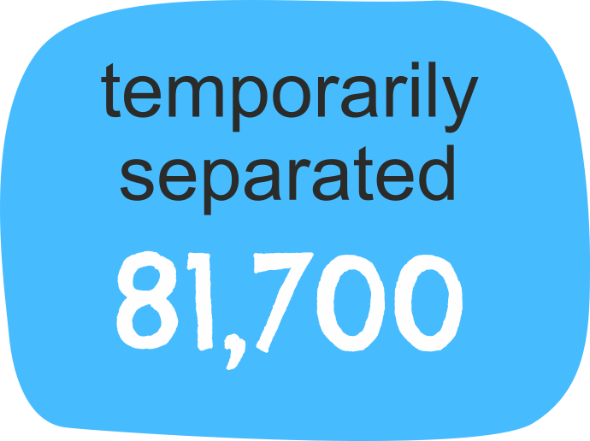
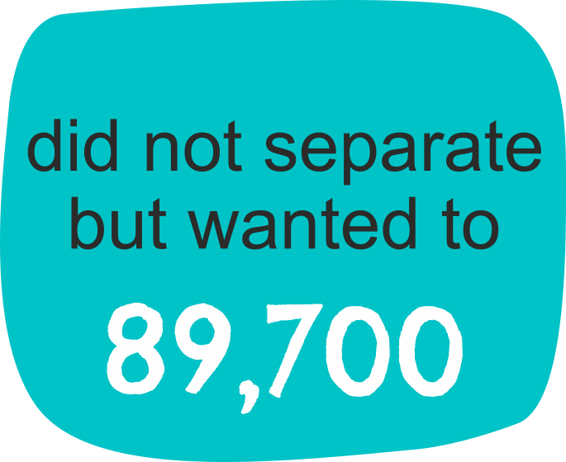
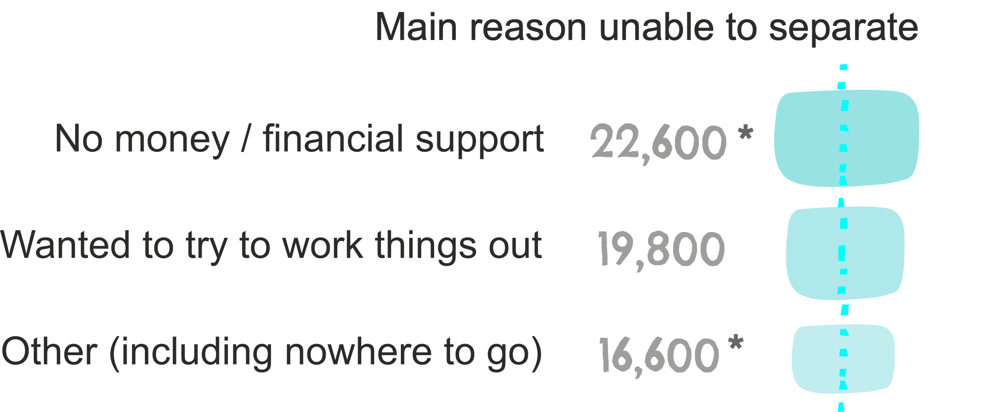
a portrait of partner violence
experienced violence
while living with their
current partner
from violent partner
Source: ABS Personal Safety Survey 2016 Table 22.1

Slide 3
rates of partner violence
of all women have experienced partner violence
of all women who have ever had a partner
of all women who previously had a partner
of single women with kids under 18
Source: adapted from ABS Customized Data Table 1

Slide 4
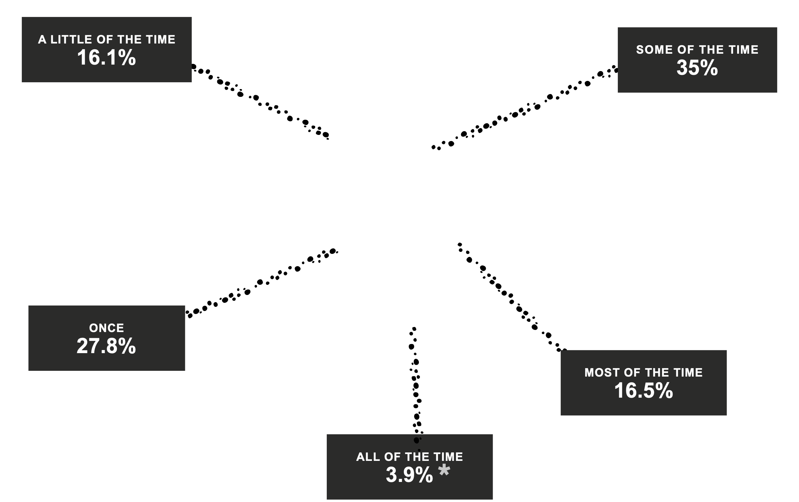
frequency of experience of partner violence
185,700 women,18 years and over, living in a single parent family with all children under 18, how often they experienced violence by their most recently violent previous partner
Source: ABS Customized Data Table 14

Slide 5
most recent of experience of physical assault
112,900 women,18 years and over, who experienced partner violence since the age of 15, now living in a single parent family with all children under 18. Characteristics of the most recent incident of physical assault by a male previous partner in the last ten years
Source: ABS Customized Data Table 12

Slide 6
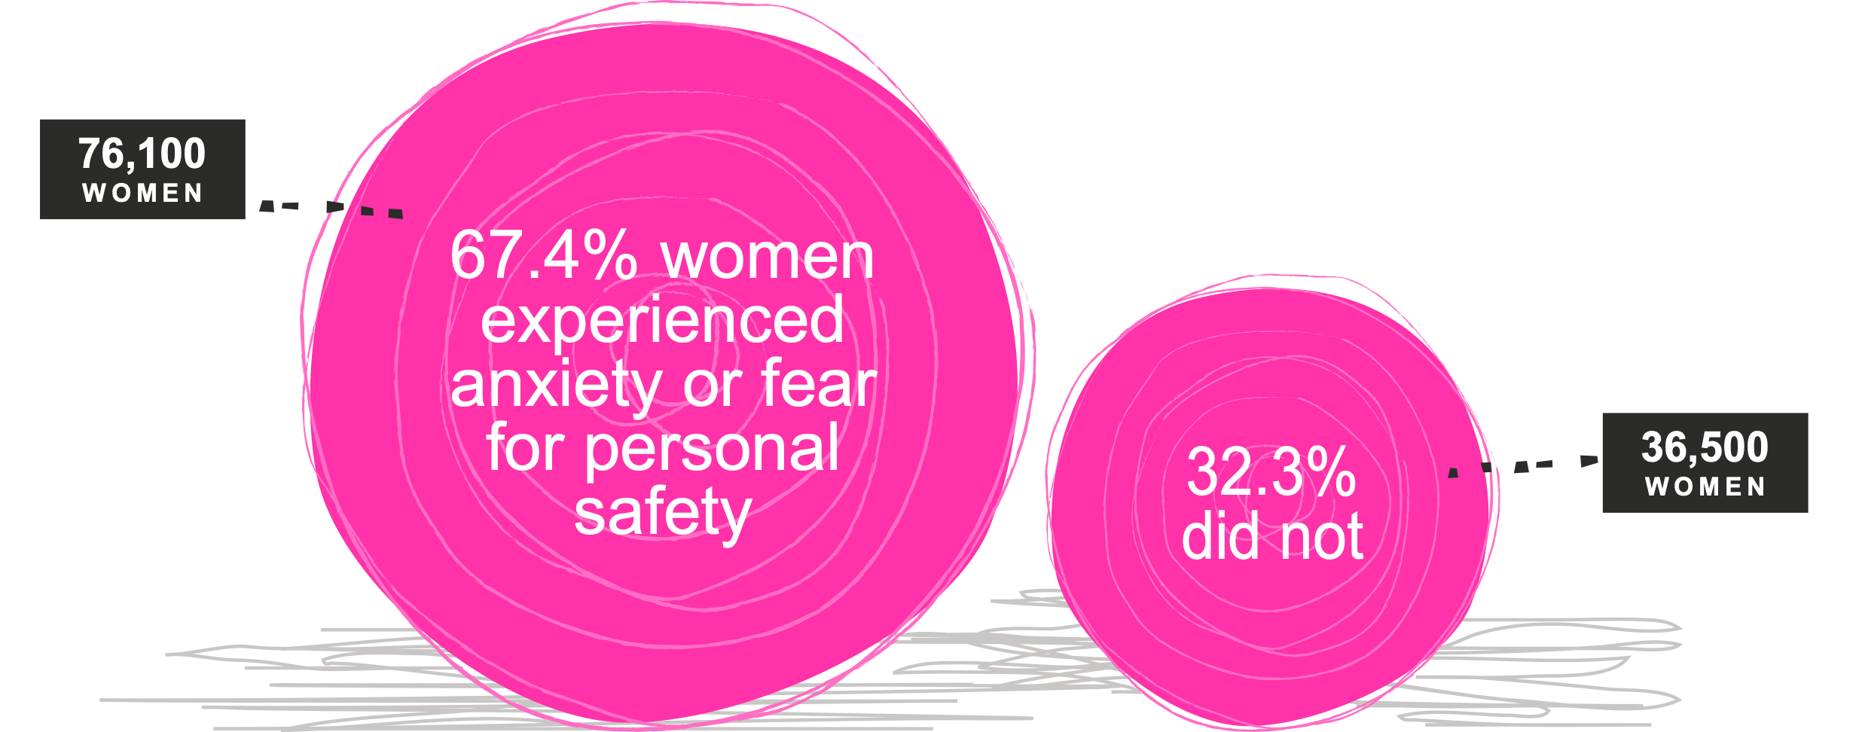
anxiety and fear due to partner violence
112,900 women,18 years and over, who experienced partner violence since the age of 15, now living in a single parent family with all children under 18. Anxiety and fear experienced in the 12 months after the most recent incident of physical assault by a male previous partner in the last ten years
Source: ABS Customized Data Table 13

Slide 7
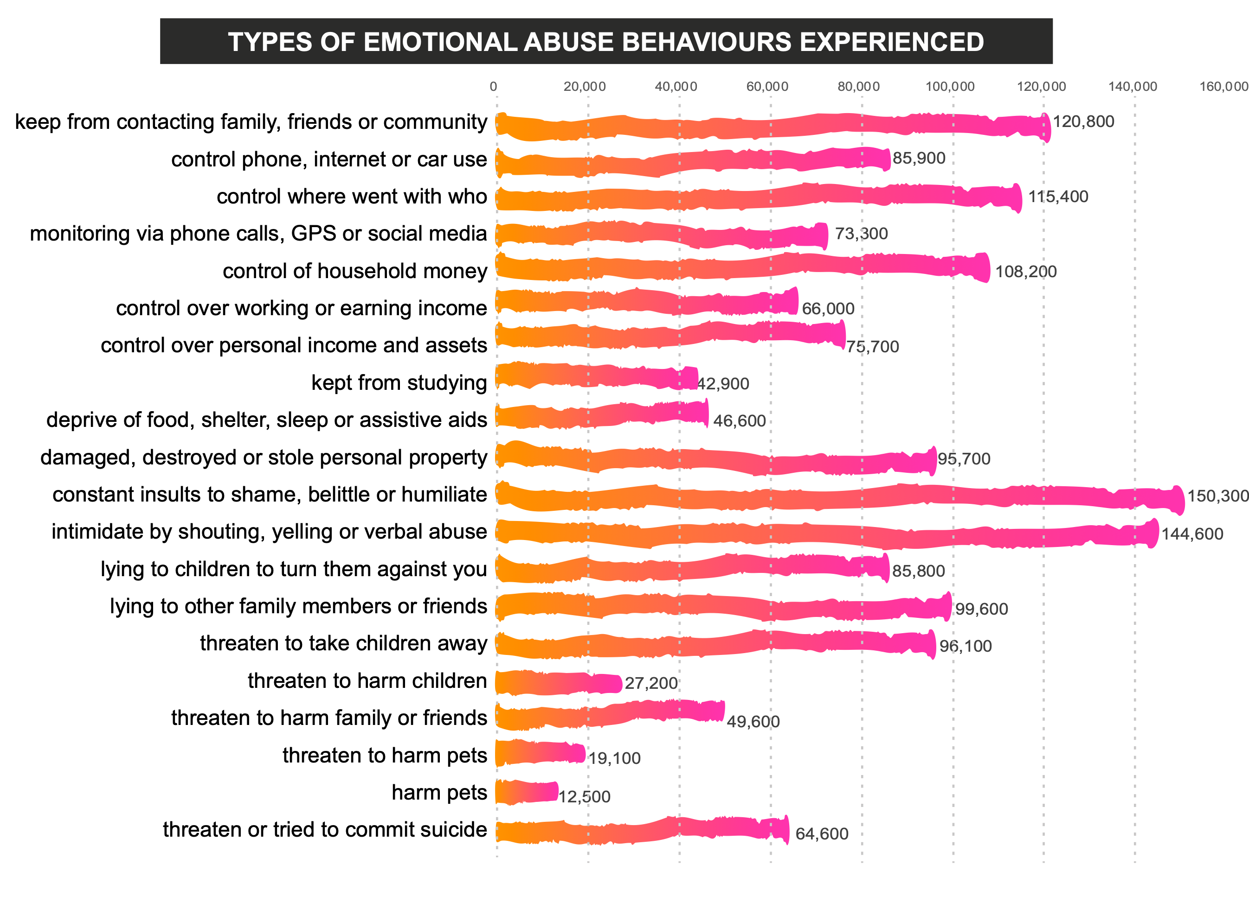
experience of emotional abuse - 1
220,200 women,18 years and over, living in a single parent family with all children under 18, who have experienced emotional abuse by a previous partner
Source: ABS Customized Data Table 19

Slide 8
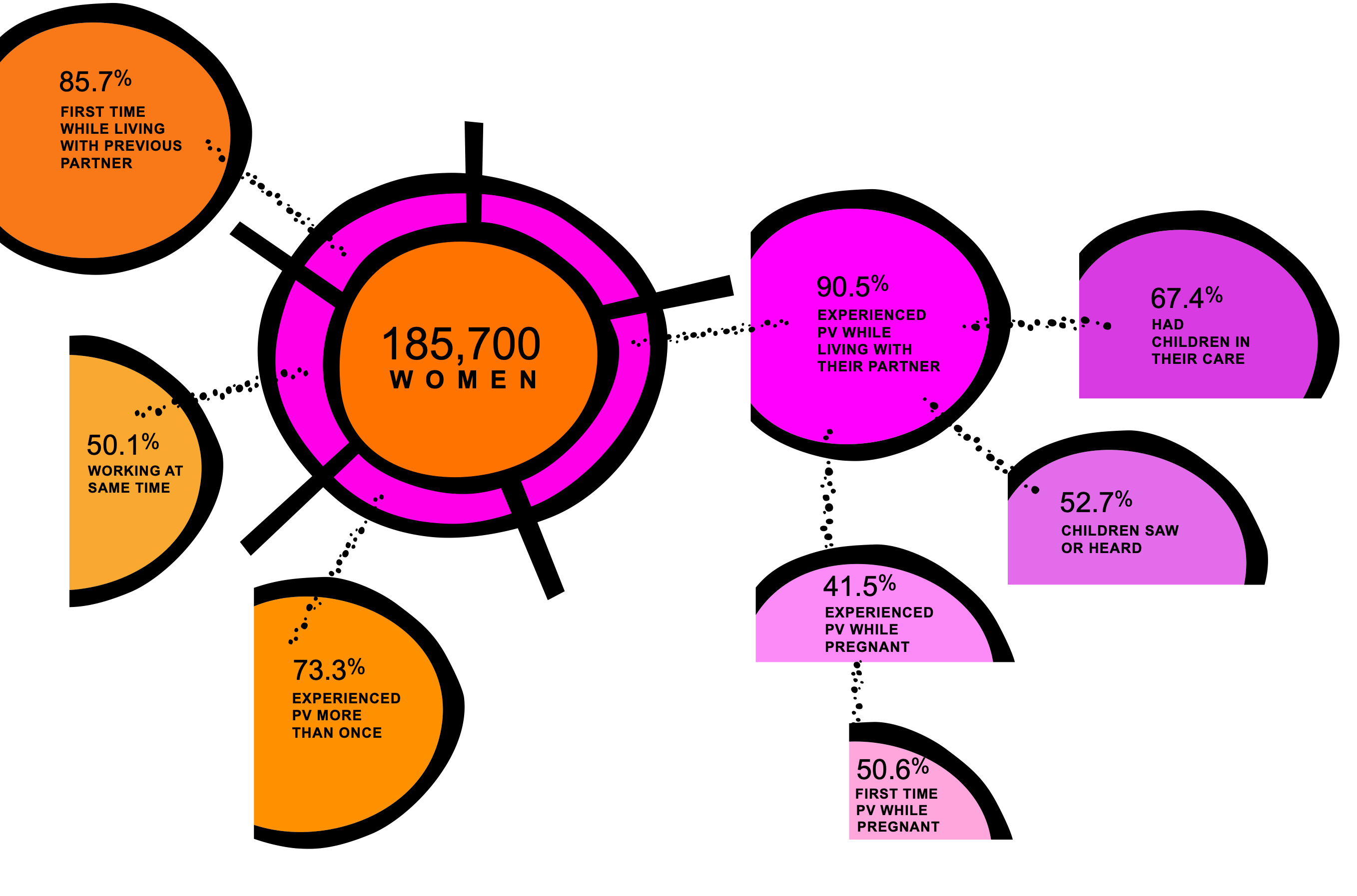
experience of partner violence
185,700 women,18 years and over, who experienced partner violence since the age of 15, now living in a single parent family with all children under 18. Characteristics of partner violence over the course of the relationship with the most recently violent previous partner
Source: ABS Customized Data Table 14

Slide 9
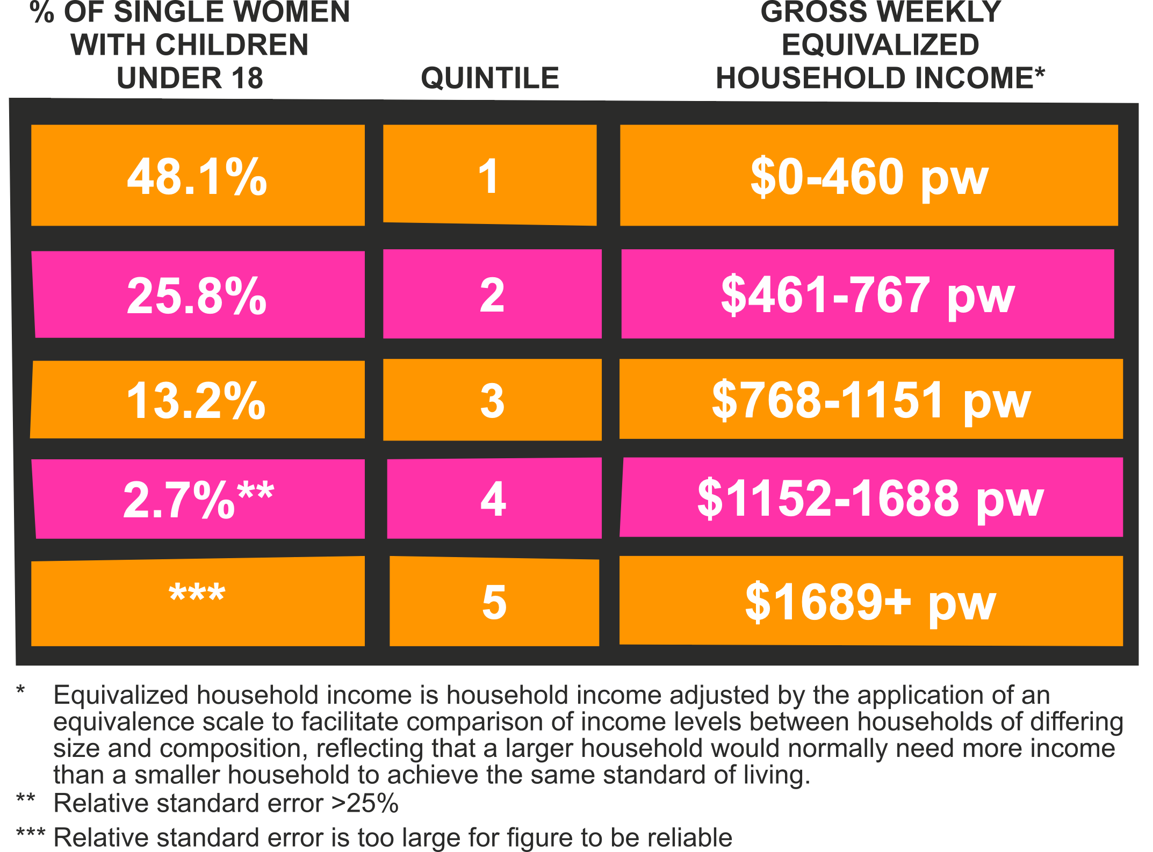
household income
185,700 women,18 years and over, living in a single parent family with all children under 18, having experienced partner violence since age 15
Source: ABS Customized Data Table 7 Income figures: https://www.abs.gov.au/ausstats/abs@.nsf/Lookup/49a06.0.55.003Appendix12016

Slide 10
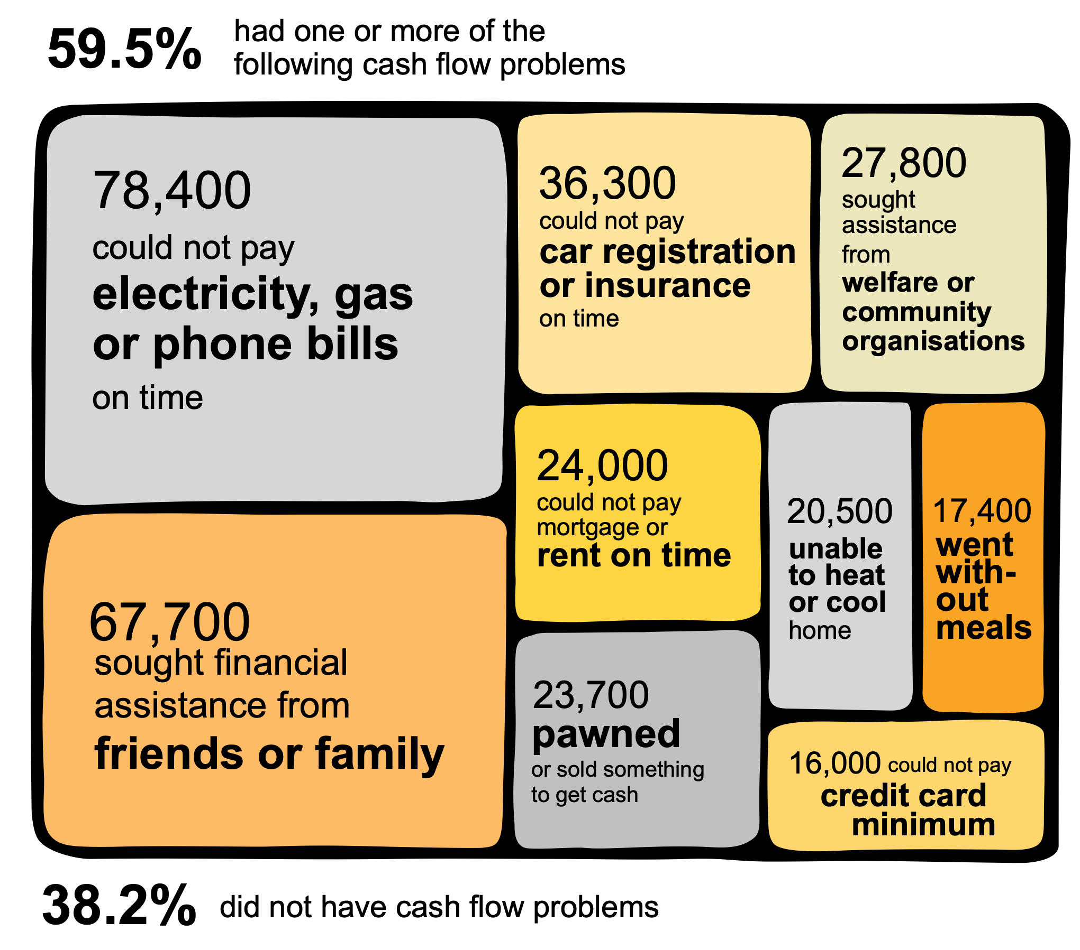
cash flow problems in the last 12 months
185,700 women,18 years and over, living in a single parent family with all children under 18, who ever had a partner, having experienced partner violence since age 15
Source: ABS Customized Data Table 7

Slide 11
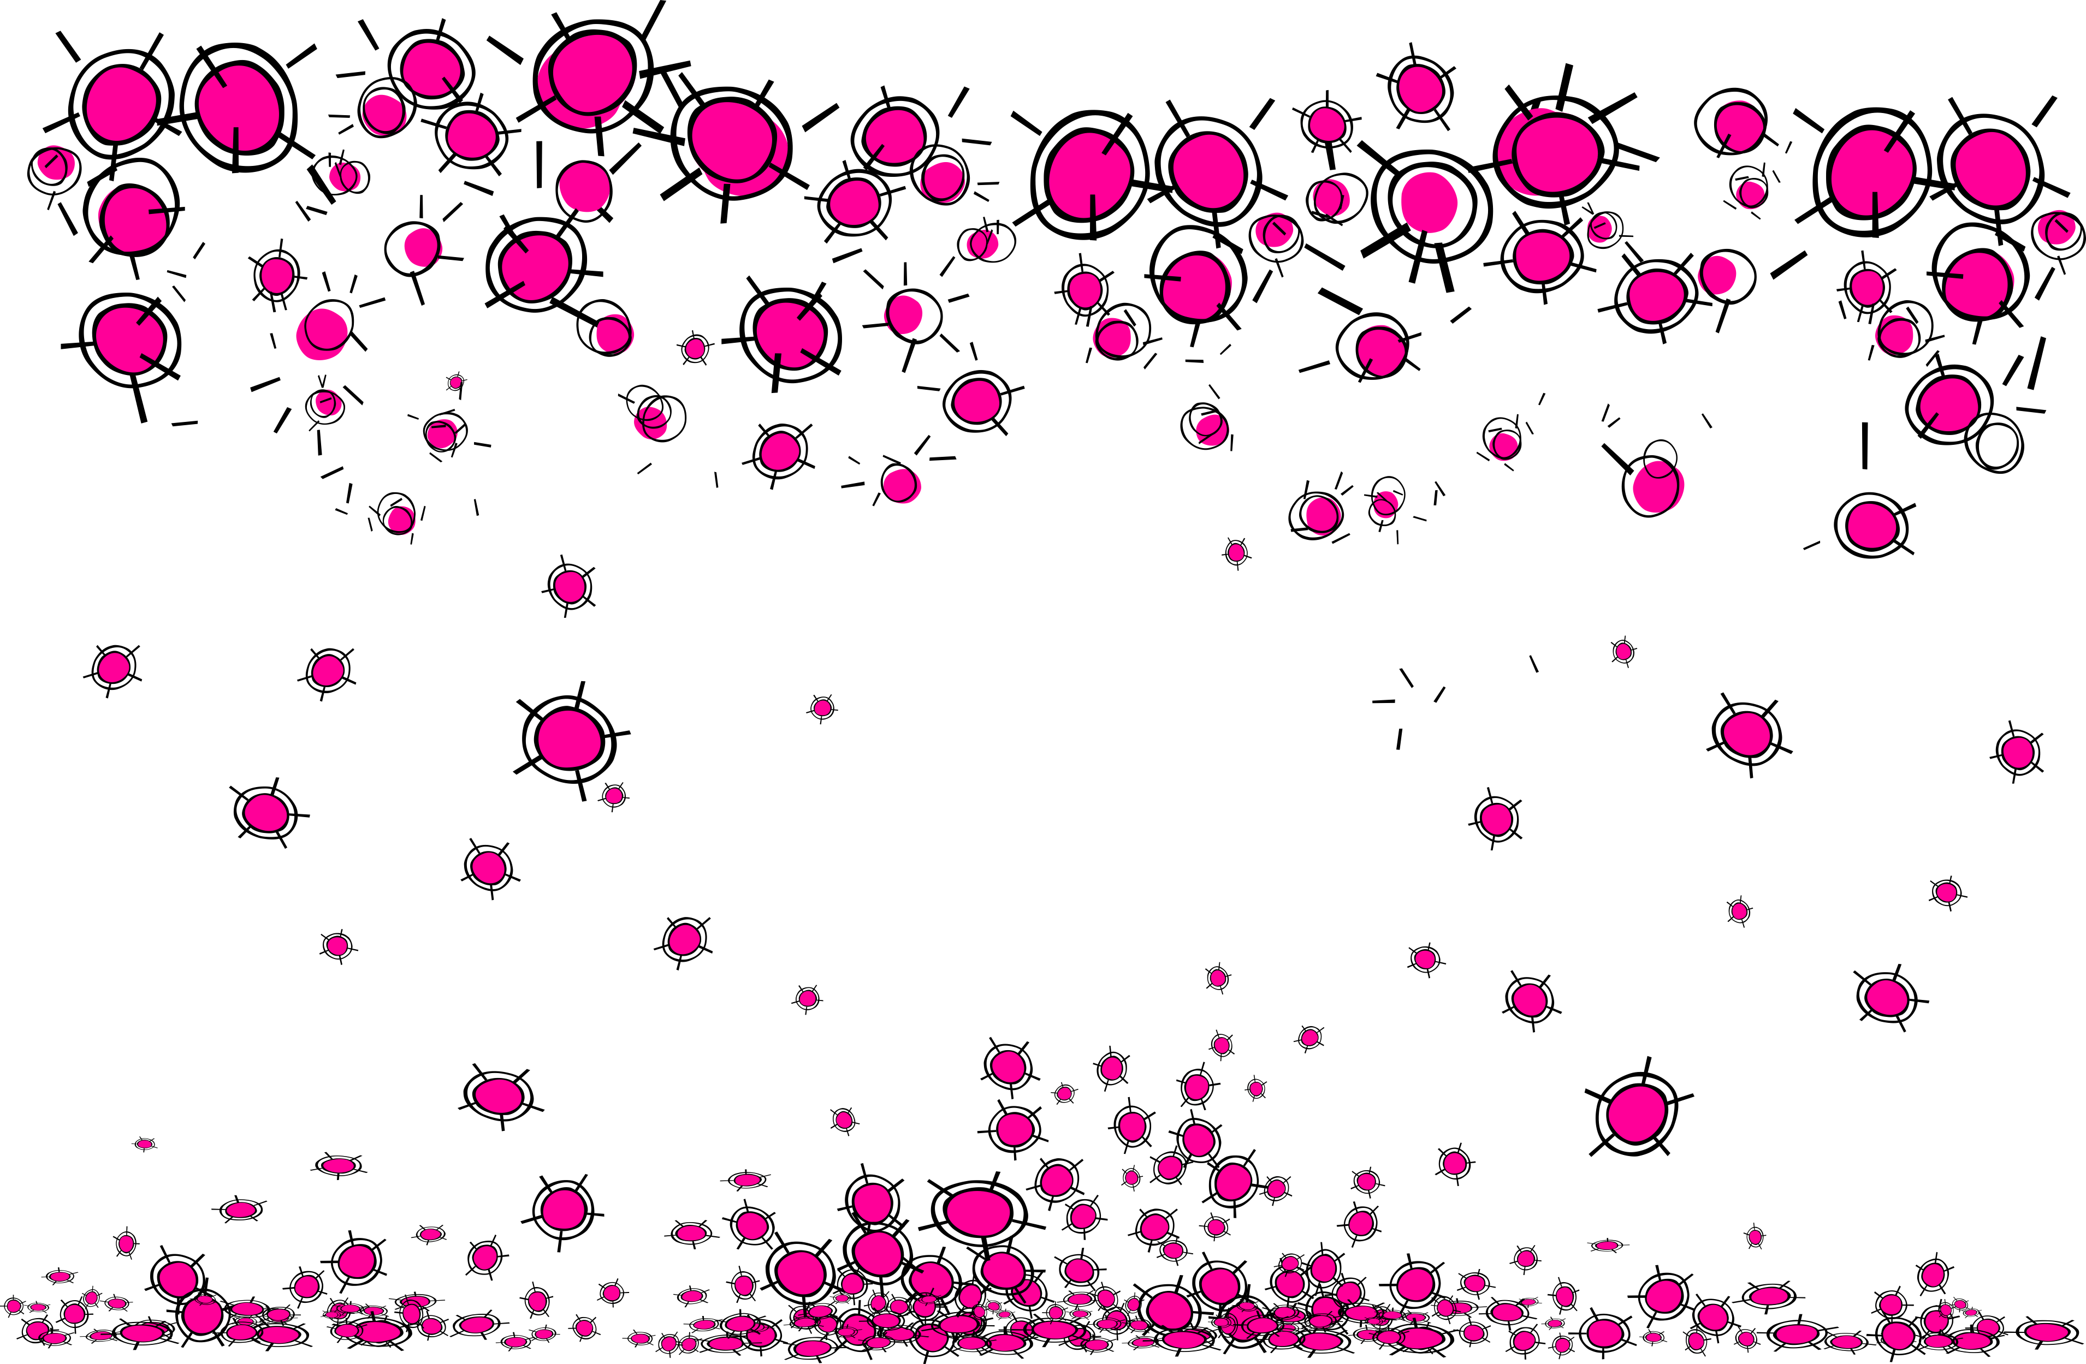

Slide 12
www.violenceorpoverty.com

Slide 13
www.violenceorpoverty.com

