Slide 1
UTS HELPS
How to Write a
Reflective Paper

Slide 2
Workshop Objectives
To understand the genre of reflective writing in terms of purpose, language and structure.
To examine useful questions to ask yourself to help write reflectively.
To identify key features of reflective writing in sample paragraphs.

Slide 3
DISCUSSION
Have you had to write reflectively before?
What did you have to write about?
How was it different to writing an essay or report?

Slide 4
What is Reflective Writing?
It maps the progress and changes in your thinking about a subject or a topic, or about the learning journey in which you have engaged.
Notes:
Generally, a reflective piece of writing requires you to map the progress and changes in your thinking about a subject or a topic, or about the learning journey in which you have engaged.
To reflect (verb) = to think deeply about / to carefully consider.
Writing a reflective piece of writing may include some of the following:
You may be asked to make regular entries in a journal (over a period of time), which will then have to be submitted and assessed. You may also be asked to use your reflections built up over a period of time as the basis of an essay or a report.
If the journal is to be assessed, it should be well-structured and clearly expressed for the benefit of your audience, even though it may have elements of personal writing.
If the journal is for yourself and is to be used as the basis of an essay or a report, make sure that your writing will make sense to you when you refer to it to compose your essay or report.

Slide 5
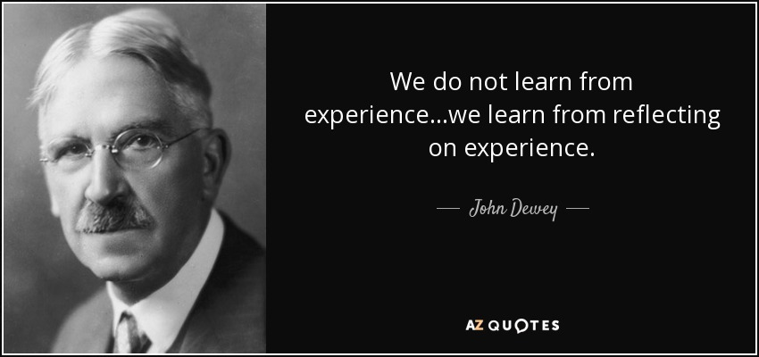
Source: http://www.azquotes.com/quote/497608
Notes:
And this quote neatly sums up why we need to learn to reflect well on our experiences.

Slide 6
Which option is more reflective?
A:
During my time working in a fast food outlet, shifts were often understaffed and rostered staff were always busy. This sometimes lead to small accidents, such as burns from the oven if staff didn’t take proper care when opening the oven doors. Customers didn’t like to be kept waiting so we kept working quickly.
B:
During my time working in a fast food outlet, shifts were often understaffed and rostered staff were always busy. This sometimes lead to small accidents, such as burns from the oven if staff didn’t take proper care when opening the oven doors. Even though we were busy and didn’t want customers to wait long for their food, the risk of serious injury to staff members was quite high. Not only would a serious injury have created more stress for my team members, it would have had an impact on customers and potentially the reputation of the fast food outlet. Some procedures we could have implemented to increase staff safety include…..

Slide 7
Which option is more reflective?
A:
During my time working in a fast food outlet, shifts were often understaffed and rostered staff were always busy. This sometimes lead to small accidents, such as burns from the oven if staff didn’t take proper care when opening the oven doors. Customers didn’t like to be kept waiting so we kept working quickly.
B:
During my time working in a fast food outlet, shifts were often understaffed and rostered staff were always busy. This sometimes lead to small accidents, such as burns from the oven if staff didn’t take proper care when opening the oven doors. Even though we were busy and didn’t want customers to wait long for their food, the risk of serious injury to staff members was quite high. Not only would a serious injury have created more stress for my team members, it would have had an impact on customers and potentially the reputation of the fast food outlet. Some procedures we could have implemented to increase staff safety include…..
Notes:
Identifying the main problem/issue.

Slide 8
Which option is more reflective?
A:
During my time working in a fast food outlet, shifts were often understaffed and rostered staff were always busy. This sometimes lead to small accidents, such as burns from the oven if staff didn’t take proper care when opening the oven doors. Customers didn’t like to be kept waiting so we kept working quickly.
B:
During my time working in a fast food outlet, shifts were often understaffed and rostered staff were always busy. This sometimes lead to small accidents, such as burns from the oven if staff didn’t take proper care when opening the oven doors. Even though we were busy and didn’t want customers to wait long for their food, the risk of serious injury to staff members was quite high. Not only would a serious injury have created more stress for my team members, it would have had an impact on customers and potentially the reputation of the fast food outlet. Some procedures we could have implemented to increase staff safety include…..
Notes:
Identifying other potential negative outcomes caused by this issue

Slide 9
Which option is more reflective?
A:
During my time working in a fast food outlet, shifts were often understaffed and rostered staff were always busy. This sometimes lead to small accidents, such as burns from the oven if staff didn’t take proper care when opening the oven doors. Customers didn’t like to be kept waiting so we kept working quickly.
B:
During my time working in a fast food outlet, shifts were often understaffed and rostered staff were always busy. This sometimes lead to small accidents, such as burns from the oven if staff didn’t take proper care when opening the oven doors. Even though we were busy and didn’t want customers to wait long for their food, the risk of serious injury to staff members was quite high. Not only would a serious injury have created more stress for my team members, it would have had an impact on customers and potentially the reputation of the fast food outlet. Some procedures we could have implemented to increase staff safety include…..
Notes:
Identifying how this problem could have been addressed.

Slide 10
Reflective Essays / Journals
Are based on feelings and personal experiences: uses first person ‘I’
Have no ‘right’ answer
Examine what happened, how and why
Identify strengths and areas for future improvement

Slide 11
What are some features of reflective writing in this sample?
Our team comprised five members and were all delegated with a particular role within the simulation. Reflecting upon my role as ‘key negotiator’, I felt at the time that this did not suit my personal profile. Largo and Johns (2008) state that ensuring close matches between simulation and real-life personality traits is more likely to produce positive results. For me, perhaps the most challenging part of being assigned this role was working and communicating effectively with our team in a clear and assertive way. Occasionally, I felt uneasy negotiating with other team members who I felt had their ‘own agenda’ and seemed unwilling at times to compromise. In hindsight, this was one of the biggest challenges I faced in this activity. However, it also allowed me to build my skills and confidence in these areas over the number of weeks we were involved in the simulation.
Notes:
Text from here: https://www.uts.edu.au/sites/default/files/Critical%20Reflective%20Writing%20%28Sample%20Essay%20-%20General%29.pdf

Slide 12
What are some features of reflective writing in this sample?
Our team comprised five members and were all delegated with a particular role within the simulation. Reflecting upon my role as ‘key negotiator’, I felt at the time that this did not suit my personal profile. Largo and Johns (2008) state that ensuring close matches between simulation and real-life personality traits are more likely to produce positive results. For me, perhaps the most challenging part of being assigned this role was working and communicating effectively with our team in a clear and assertive way. Occasionally, I felt uneasy negotiating with other team members who I felt had their ‘own agenda’ and seemed unwilling at times to compromise. In hindsight, this was one of the biggest challenges I faced in this activity. However, it also allowed me to build my skills and confidence in these areas over the number of weeks we were involved in the simulation.
Notes:
The focus is on the writer (and therefore uses 1st person)
The wrier explains their feelings about the situation.
Focus on what was difficult/problematic about the situation
Focus on what the writer learnt and/or what skills s/he developed from this experience.
Linking their personal experience with what the literature says about these types of situations.

Slide 13
What are some features of reflective writing in this sample?
The role that effective communication played within the simulation was of key importance and the chance to personally critically reflect upon this is also as important. Nixon (2014), Johnson and Wiggs (2011) and Peterson (2021) all state that effective communication within a team dynamic is essential. This is further supported by research (Wu & Xiao 2011; Peterson 2021) that claims that team members need to employ open dialogue and have clear agendas. To comment upon my communicative style, it appeared that I tried to not compromise myself but be as Danks (2021, p. 24) states “a clear and reasoned thinker and communicator”. For the most part, our group exchanged information well and it could be argued that we mostly achieved goals through effective dialogue, clear understanding and working as a cohesive team. In summary then, it can be acknowledged that our team communicated effectively throughout this simulation and upon reflection, this clearly aided us in reaching our goals.
Notes:
Possible additional example for activity.
Text from here: https://www.uts.edu.au/sites/default/files/Critical%20Reflective%20Writing%20%28Sample%20Essay%20-%20General%29.pdf

Slide 14
What are some features of reflective writing in this sample?
The role that effective communication played within the simulation was of key importance and the chance to personally critically reflect upon this is also as important. Nixon (2014), Johnson and Wiggs (2011) and Peterson (2021) all state that effective communication within a team dynamic is essential. This is further supported by research (Wu & Xiao 2011; Peterson 2021) that claims that team members need to employ open dialogue and have clear agendas. To comment upon my communicative style, it appeared that I tried to not compromise myself but be as Danks (2021, p. 24) states “a clear and reasoned thinker and communicator”. For the most part, our group exchanged information well and it could be argued that we mostly achieved goals through effective dialogue, clear understanding and working as a cohesive team. In summary then, it can be acknowledged that our team communicated effectively throughout this simulation and upon reflection, this clearly aided us in reaching our goals.
Notes:
Text from here: https://www.uts.edu.au/sites/default/files/Critical%20Reflective%20Writing%20%28Sample%20Essay%20-%20General%29.pdf

Slide 15
How do I structure a reflective piece?
Check your instructions, as you could be given a particular reflective model to use
Check with your tutor if you’re unsure!
If in doubt, the next slides show a couple of useful structures
Source: https://student.unsw.edu.au/how-do-i-write-reflectively

Slide 16
A Simple Model for Reflection
What?
So What?
Now What?
What happened in this situation?
What was important about it and what did it mean?
What will you change as a result of reflecting on your experience?
Adapted from: Rolfe, G., Freshwater, D., & Jasper, M. 2001, Critical reflection for nursing and the helping professions: a user’s guide, Palgrave Macmillan, Basingstoke.
Notes:
This model is simple but effective, as it captures the most important elements of a reflection:
1. Explain who, what, when, where and why the situation happened.
2. Explain what you thought/felt about it, or what impact it had on others.
3. How will it change your behaviour, or what would you do differently next time?

Slide 17
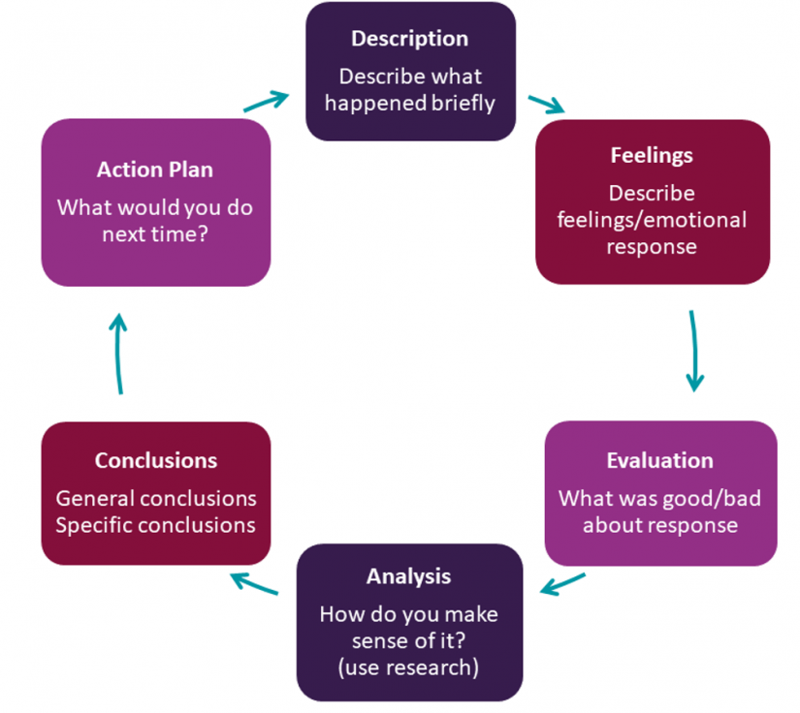
The Gibbs Reflective Model
Adapted from: Gibbs G. (1988). Learning by Doing: A guide to teaching and learning methods. Further Education Unit. Oxford Polytechnic: Oxford
Notes:
This model essentially captures the same things, but breaks them into slightly more specific steps.
The analysis section is the main difference compared with the What/So What/Now What model, as analysis requires you to link the situation with existing research or theories that can help explain the situation, or help you see it in a different way. This is frequently (but not always) required in reflective tasks at university.

Slide 18
Some guiding questions for reflective thinking are:
What happened and why ?
What was my role and why did I adopt that particular role?
What were my thoughts/feelings during that experience? Why did I think/feel that way?
What might this experience mean?
What other perspectives, theories or concepts could be applied to interpret the situation?
How can I learn from this experience?
Source: http://www.deakin.edu.au/students/studying/study-support/academic-skills/reflective-writing

Slide 19
ACTIVITY
Think about a negative (or positive) experience you’ve had recently. Answer the questions below to practice thinking reflectively:
What happened during that event or experience? And why did it happen?
What was my role in the event? And why did I adopt that particular role?
What were my feelings during that experience? And why did I feel that way?
What were my thoughts during that experience? And why did I think that way?
How can I learn from this experience?
Notes:
Discuss in pairs or small groups. Give students a few minutes to think about it first, and jot down some notes to help them remember, prior to discussing with a partner or group.

Slide 20
Questions to guide reflective learning
What do I now know that I did not before?
What perceived strengths and weaknesses did I observe?
What challenges did I encounter (or observe) and how well were they handled?
Did I use anything I’d learnt to help me respond to the situation?
What does the research say about effective ways of responding to this type of situation?
What would I do better next time and with what anticipated results?
Notes:
All reflection is ultimately aimed at improving the way you approach or respond to certain situations, so the key is to show what you've learnt by reflecting on the issue, which may also involve reflecting on the literature related to this issue.

Slide 21

Notes:
There are more examples of reflective writing in our self-help resources.

Slide 22
Discover these!
Online self-help learning resources
Drop-in & 1:1 consultations
Conversations@UTS
Intensive Academic English Programmes
Daily Workshops
Volunteer Programmes
 www.helps.uts.edu.au

Slide 23
UTS HELPS
 9514 9733
 helps@uts.edu.au
 www.helps.uts.edu.au
.

